Slide 1


Y5 M4k. Can read, write, order and compare numbers with up to three decimal places
Commissioned by The PiXL Club Ltd.
August 2018
This resource is strictly for the use of member schools for as long as they remain members of The PiXL Club. It may not be copied, sold nor transferred to a third party or used by the school after membership ceases. Until such time it may be freely used within the member school.
All opinions and contributions are those of the authors. The contents of this resource are not connected with nor endorsed by any other company, organisation or institution.
PiXL Club Ltd endeavour to trace and contact copyright owners. If there are any inadvertent omissions or errors in the acknowledgements or usage, this is unintended and PiXL will remedy these on written notification.
© Copyright The PiXL Club Limited, 2018

Slide 2
Teachers’ Notes
The purpose of the priority therapies is to support the teaching of fundamental concepts for the year group.
The therapies can be taught to a whole class or a target group. Year 5 therapies are designed to take approximately 30 minutes. However, this is flexible: it may be that only part of the therapy is taught or it could, of course, be adapted or extended.
A vocabulary slide is included in each therapy. This identifies key words which relate to the taught concept along with a link to the ‘Vocabulary Shorts’ on PrimaryWise (20 activities to develop vocabulary). The intention is that the therapy begins with explicit teaching of this vocabulary.
The therapy adopts the ‘Teach, model and apply’ process with plenty of opportunities for pupils to demonstrate the taught skill.
Problem solving and reasoning activities are an integral part of each therapy.

Slide 3
Vocabulary: fractions
tenth
hundredth
thousandth
ascending
descending
Please select an activity from the ‘Vocabulary Shorts’ to develop understanding of the key vocabulary.

Slide 4

Teach
What is each column called on a place value grid?
Thousands | Hundreds | Tens | Ones | Tenths | Hundredths | Thousandths
Notes:
Click when in slideshow mode to remove the orange boxes one at a time.

Slide 5
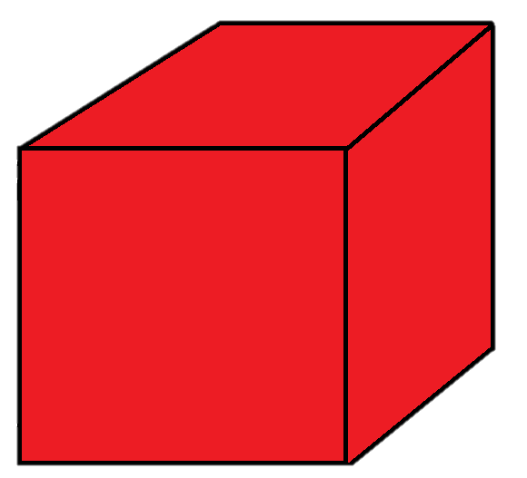
Teach
Let’s use base ten equipment to understand what these decimal numbers represent.
This can represent one whole.
This can represent one tenth.
This can represent one hundredth.
This can represent one thousandth.

Slide 6
Teach
You can see that as each column gets smaller, the number gets ten times smaller.
This can represent one whole.
This can represent one tenth.
This can represent one hundredth.
This can represent one thousandth.

Slide 7
Teach
So, for example, 4.321 would look like this.
3 tenths.
1 thousandth.
4 ones.
2 hundredths.

Slide 8
Teach
Whereas, 1.234 would look like this.
2 tenths.
4 thousandths.
1 one.
3 hundredths.

Slide 9
Model
Both of these numbers have the same digits but their place value makes them different amounts. Which is larger? Explain why.
1.234
4.321
1 thousandth.
4 thousandths.
3 tenths.
2 tenths.
3 hundredths.
4 ones.
2 hundredths.
1 one.

Slide 10
Model
When we are comparing decimals, we need to look at the largest column first, as this influences the size of the number the most.
1.234
4.321
1 thousandth.
4 thousandths.
3 tenths.
2 tenths.
3 hundredths.
4 ones.
2 hundredths.
1 one.

Slide 11
Model
We can see that 4.321 is larger than 1.234.
>
1.234
4.321
1 thousandth.
4 thousandths.
3 tenths.
2 tenths.
3 hundredths.
4 ones.
2 hundredths.
1 one.

Slide 12
Model
Which is larger? Check the size of each place value column starting with the largest column.
1.101
1.110
1 tenth.
1 thousandth.
1 tenth.
0 thousandths.
1 one.
0 hundredths.
1 one.
1 hundredth.

Slide 13
Model
We can see that 1.110 is larger. Both numbers have 1 one and 1 tenth, but 1.110 has 1 hundredth whereas the first number has none.
<
1.101
1.110
1 tenth.
1 thousandth.
1 tenth.
0 thousandths.
1 one.
0 hundredths.
1 one.
1 hundredth.

Slide 14
Apply
Which is larger? Show me using the greater than > or less than < symbol.
6.7 or 2.4?
4.34 or 3.43?
5.003 or 4.989?
6.066 or 6.606?

Slide 15
Teach
Sometimes we might need to order or compare decimals with a different number of digits.
Thousands | Hundreds | Tens | Ones | Tenths | Hundredths | Thousandths
 |  |  | 1 | 4 | 3
Thousands | Hundreds | Tens | Ones | Tenths | Hundredths | Thousandths
 |  |  | 1 | 7

Slide 16
Model
Let’s make these decimal numbers using place value equipment again to compare their size.
1.7
1.43
7 tenths.
4 tenths.
1 one.
3 hundredths.
1 one.

Slide 17
Model
Even though we have the same amount of equipment for each number, the 7 tenths is much bigger than 4 tenths and 3 hundredths.
1.7
1.43
7 tenths.
4 tenths.
1 one.
3 hundredths.
1 one.

Slide 18
Model
We can see that 1.7 is larger than 1.43.
<
1.7
1.43
7 tenths.
4 tenths.
1 one.
3 hundredths.
1 one.

Slide 19
Model
When comparing without equipment, it is really important to start by looking at the largest column (here it is the ones) and compare this first.
1.7
1.43
7 tenths.
4 tenths.
1 one.
3 hundredths.
1 one.

Slide 20
Model
Here, they are the same, so we move to the next largest column (here, the tenths) and compare these digits.
1.7
1.43
7 tenths.
4 tenths.
1 one.
3 hundredths.
1 one.

Slide 21
Model
As 7 tenths is larger than 4 tenths, 1.7 must be larger than 1.43. It doesn’t matter what digits come next, as they are too small to make a difference.
<
1.7
1.43
7 tenths.
4 tenths.
1 one.
3 hundredths.
1 one.

Slide 22
Model
Let’s do one more together without any equipment to help us.

Slide 23
Model
Which is larger?
16.089
16.1

Slide 24
Model
First, we look at the tens column.
16.089
16.1

Slide 25
Model
As the tens column is the same, we next need to look at the next largest column, ones column.
16.089
16.1

Slide 26
Model
This is also the same, so we look at the tenths column.
16.089
16.1

Slide 27
Model
This is different. One tenth is larger than no tenths. Therefore, 16.1 is larger than 16.089.
16.089
16.1

Slide 28
Model
It doesn’t matter what is in the next smallest columns, as it is too small to make a difference.
16.089
<
16.1

Slide 29
Model
Do not be confused by the number of digits. 16.089 has more digits but 16.1 is still a larger number.
16.089
<
16.1

Slide 30
Apply
Which is larger? Show me using the greater than or less than symbol.
5.6 or 2.53?
8.034 or 8.3?
2.34 or 2.23?
6.43 or 6.431?

Slide 31
Model
Order the following numbers in ascending order (smallest to largest).
4.05
4.15
0.44
4.14

Slide 32
Model
First, we look at the largest column - the ones column.
4.05
4.15
0.44
4.14

Slide 33
Model
We can see that the smallest number is 0.44. We write this as the first number in ascending order and cross it off the list.
4.05
4.15
0.44
4.14
0.44

Slide 34
Model
Next, we look at the next largest number – the tenths column.
4.05
4.15
0.44
4.14
0.44

Slide 35
Model
4.05 must be the smallest of the remaining numbers, as it has no tenths whereas the other two numbers have one tenth.
4.05
4.15
0.44
4.14
0.44

Slide 36
Model
We add the number to our list and cross it out.
4.05
4.15
0.44
4.14
0.44, 4.05

Slide 37
Model
Finally, we look at the next largest column, the hundredths column.
4.05
4.15
0.44
4.14
0.44, 4.05

Slide 38
Model
We can see that 4.14 must be smaller than 4.15, as it has four hundredths rather than five.
4.05
4.15
0.44
4.14
0.44, 4.05

Slide 39
Model
So, we add 4.14 to our list and finally add 4.15 to our list as the largest number.
4.05
4.15
0.44
4.14
0.44, 4.05, 4.14, 4.15

Slide 40
Model
Now, all of our numbers are in ascending order.
4.05
4.15
0.44
4.14
0.44, 4.05, 4.14, 4.15

Slide 41
Apply
Finally, put the following numbers in ascending order.
6.7 7.6 6.07 7.06
23.2 2.23 3.23 23.3
7.141 0.714 71.4 7.41

Slide 42


Evaluate
Can you read, write, order and compare numbers with up to three decimal places?

