Slide 1


Y5 M4m. Can recognise the % symbol and understand that it relates to the number of parts per hundred
Commissioned by The PiXL Club Ltd.
August 2018
This resource is strictly for the use of member schools for as long as they remain members of The PiXL Club. It may not be copied, sold nor transferred to a third party or used by the school after membership ceases. Until such time it may be freely used within the member school.
All opinions and contributions are those of the authors. The contents of this resource are not connected with nor endorsed by any other company, organisation or institution.
PiXL Club Ltd endeavour to trace and contact copyright owners. If there are any inadvertent omissions or errors in the acknowledgements or usage, this is unintended and PiXL will remedy these on written notification.
© Copyright The PiXL Club Limited, 2018

Slide 2
Teachers’ Notes
The purpose of the priority therapies is to support the teaching of fundamental concepts for the year group.
The therapies can be taught to a whole class or a target group. Year 5 therapies are designed to take approximately 30 minutes. However, this is flexible: it may be that only part of the therapy is taught or it could, of course, be adapted or extended.
A vocabulary slide is included in each therapy. This identifies key words which relate to the taught concept along with a link to the ‘Vocabulary Shorts’ on PrimaryWise (20 activities to develop vocabulary). The intention is that the therapy begins with explicit teaching of this vocabulary.
The therapy adopts the ‘Teach, model and apply’ process with plenty of opportunities for pupils to demonstrate the taught skill.
Problem solving and reasoning activities are an integral part of each therapy.

Slide 3
Vocabulary: fractions
percent
percentage
hundredth
fraction
Please select an activity from the ‘Vocabulary Shorts’ to develop understanding of the key vocabulary.

Slide 4

Teach
When have you seen the % symbol?

Slide 5
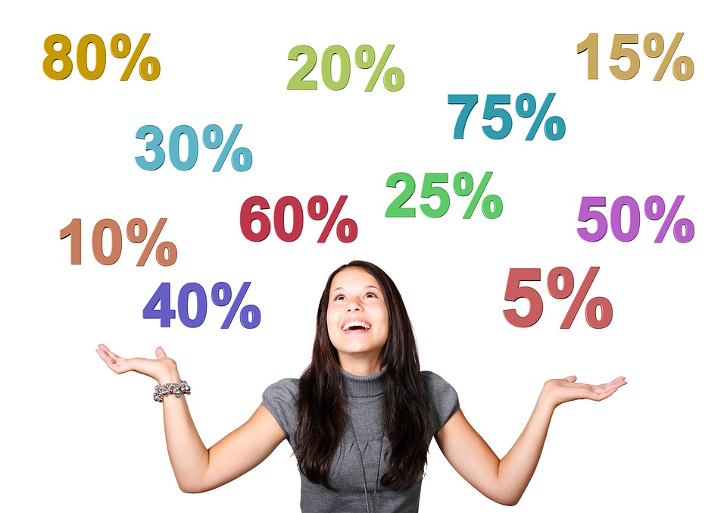
Teach
You might have seen the % symbol in shops, on advertisements or for quiz results.

Slide 6
Teach
What does % mean?

Slide 7
Teach
%
% is the percent symbol.
It shows you the number of parts per hundred.

Slide 8

Teach
1
100
1%
1% means one part out of every hundred.

Slide 9
Model
What do you think 10% represents as a fraction and a diagram?
___
100
10%

Slide 10
Model
What do you think 10% represents as a fraction and a diagram?
10
___
100
10%

Slide 11
Apply
What do you think 25% represents as a fraction and a diagram?
___
100
25%

Slide 12
Apply
What do you think 25% represents as a fraction and a diagram?
What do you notice about this special percentage?
25
___
100
25%
Notes:
Discuss equivalence to one quarter.

Slide 13
Apply
What do you think 50% represents as a fraction and a diagram?
___
100
50%

Slide 14
Apply
What do you think 50% represents as a fraction and a diagram?
What do you notice about this special percentage?
50
___
100
50%
Notes:
Discuss equivalence to one half.

Slide 15
Apply
What do you think 75% represents as a fraction and a diagram?
___
100
75%

Slide 16
Apply
What do you think 75% represents as a fraction and a diagram?
What do you notice about this special percentage?
75
___
100
75%
Notes:
Discuss equivalence to three quarters.

Slide 17
Apply
If you were hungry, would you rather have 60% of a snack or 39% of the same snack? Explain why.

Slide 18
Apply
If you were hungry, would you rather have 60% of a snack or 39% of it? Explain why.
60%
39%

Slide 19
Apply
If you were hungry, would you rather have 60% of a snack or 39% of it? Explain why.
60%
As you can see from the diagrams, 60% would be greater, as 60/100 is larger than 39/100.
39%

Slide 20
Model
Percent represents parts in one hundred. So if I know one percent, I can work out what is left over by subtracting it from 100.

Slide 21
Model
For example, if 70% of my garden is grass and the rest is concrete, how much of the garden is in concrete?

Slide 22
Model
The rest must be concrete.
Garden = 100%
Grass = 70%
So Concrete = 100% - 70%
= 30%
70%
___%

Slide 23
Model
100-70 = 30
So, 30% of the garden must be concrete!
70%
___%

Slide 24
Apply
20% of a cake is icing and the rest is sponge. What percentage of the cake is sponge?

Slide 25
Apply
20% icing
20% of a cake is icing and the rest is sponge. What percentage of the cake is sponge?
80% sponge

Slide 26
Apply
45% of the walk is uphill and the rest is downhill. What percentage of the walk is downhill?

Slide 27
Apply
45% uphill
45% of the walk is uphill and the rest is downhill. What percentage of the walk is downhill?
55% downhill

Slide 28
Apply
The school day is 23% playtime and the rest is lesson time. What percentage of the day is spent in lessons?

Slide 29
Apply
23% playtime
The school day is 23% playtime and the rest is lesson time. What percentage of the day is spent in lessons?
77% lessons
Notes:
Check children’s accuracy at calculating a 2-digit number subtracted from 100. Further practise of mental subtraction methods might be needed if children are struggling at this skill.

Slide 30


Evaluate
Can you recognise the % symbol and understand that it relates to the number of parts per hundred?

