Slide 1


Y5 M5a. Can convert between different units of metric measures, using place value
Commissioned by The PiXL Club Ltd.
August 2018
This resource is strictly for the use of member schools for as long as they remain members of The PiXL Club. It may not be copied, sold nor transferred to a third party or used by the school after membership ceases. Until such time it may be freely used within the member school.
All opinions and contributions are those of the authors. The contents of this resource are not connected with nor endorsed by any other company, organisation or institution.
PiXL Club Ltd endeavour to trace and contact copyright owners. If there are any inadvertent omissions or errors in the acknowledgements or usage, this is unintended and PiXL will remedy these on written notification.
© Copyright The PiXL Club Limited, 2018

Slide 2
Teachers’ Notes
The purpose of the priority therapies is to support the teaching of fundamental concepts for the year group.
The therapies can be taught to a whole class or a target group. Year 5 therapies are designed to take approximately 30 minutes. However, this is flexible: it may be that only part of the therapy is taught or it could, of course, be adapted or extended.
A vocabulary slide is included in each therapy. This identifies key words which relate to the taught concept along with a link to the ‘Vocabulary Shorts’ on PrimaryWise (20 activities to develop vocabulary). The intention is that the therapy begins with explicit teaching of this vocabulary.
The therapy adopts the ‘Teach, model and apply’ process with plenty of opportunities for pupils to demonstrate the taught skill.
Problem solving and reasoning activities are an integral part of each therapy.

Slide 3
Vocabulary: measurement
millimetre
centimetre
metre
kilometre
litre
millilitre
gram
kilogram
convert
metric
Please select an activity from the ‘Vocabulary Shorts’ to develop understanding of the key vocabulary.

Slide 4

Teach
In which units do we measure length?

Slide 5
Teach
When might we need to measure length?

Slide 6
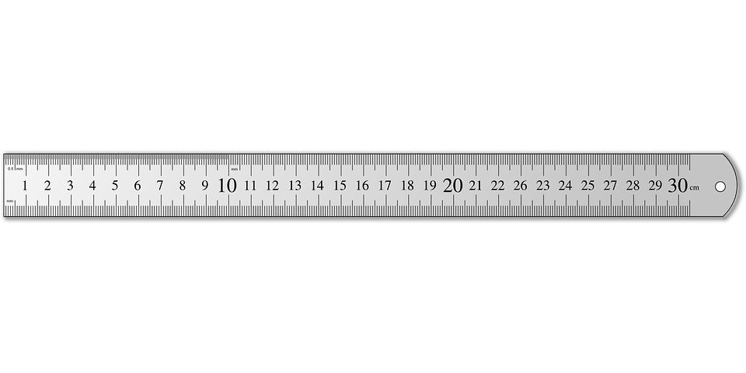

Teach
Look at your ruler. There are 10 millimetres in 1 centimetre.

Slide 7
Teach
x 10
To convert (change) between mm and cm, we need to multiply and divide by 10.
cm
mm
÷ 10

Slide 8
Model
To convert (change) 0.75cm into mm, we need to multiply by 10.
x 10
cm
mm
÷ 10

Slide 9
Model
To do this, place (or think of) 0.75 on a place value grid.
To multiply by 10, move the digits one column to the left to make the number 10 times larger.
x 10
cm
mm
Hundreds | Tens | Ones | Tenths | Hundredths
0
7
5
÷ 10
Notes:
Click once on slideshow mode to move the digit cards one space to the left.

Slide 10
Model
This number is the same without the 0. The number now reads 7.5.
x 10
cm
mm
Hundreds | Tens | Ones | Tenths | Hundredths
0
7
5
÷ 10

Slide 11
Model
So,
0.75cm = 7.5mm
x 10
cm
mm
Hundreds | Tens | Ones | Tenths | Hundredths
7
5
÷ 10

Slide 12
Model
To convert (change) 50.6mm into cm, we need to divide by 10.
x 10
cm
mm
÷ 10

Slide 13
Model
To do this, place (or think of) 50.6 on a place value grid. To divide by 10, move the digits one column to the right to make the number 10 times smaller.
x 10
cm
mm
Hundreds | Tens | Ones | Tenths | Hundredths
5
0
6
÷ 10
Notes:
Click once on slideshow mode to move the digit cards one space to the right.

Slide 14
Model
Be careful to make sure the 0 is included here as a place holder. So,
50.6mm = 5.06cm
x 10
cm
mm
Hundreds | Tens | Ones | Tenths | Hundredths
5
0
6
÷ 10

Slide 15
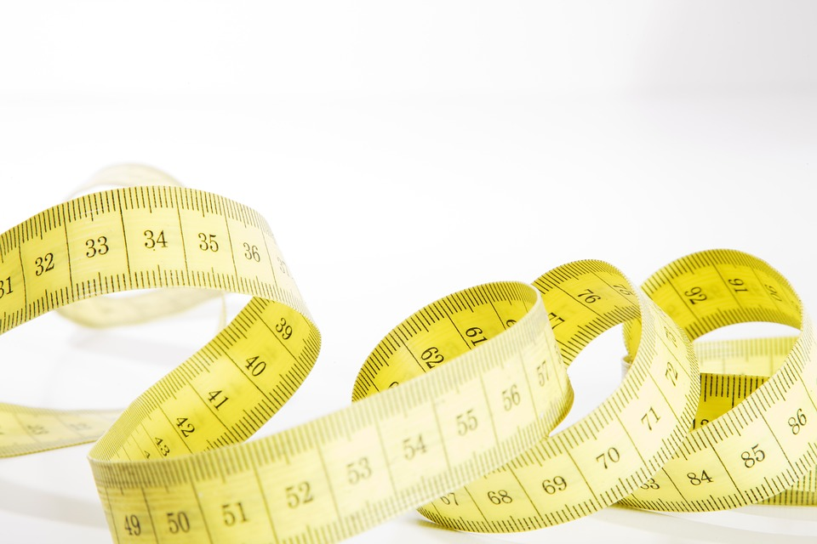
Teach
Look at a metre stick or tape measure. There are 100 centimetres in 1 metre.

Slide 16
Teach
x 100
m
cm
To convert (change) between cm and m, we need to multiply and divide by 100.
÷ 100

Slide 17
Model
Because we are multiplying and dividing by 100 this time, we need to move the digit two spaces to the left or right to make the number 100 times larger or smaller.
x 100
m
cm
÷ 100

Slide 18
Model
For example, to find how many cm are in 1.5 metres, we need to move the digits 1 and 5 two spaces to the left to make the number 100 times larger.
x 100
m
cm
Hundreds | Tens | Ones | Tenths | Hundredths
1
5
÷ 100
Notes:
Click once on slideshow mode to move the digit cards two spaces to the left.

Slide 19
Model
We then put 0 as a place holder so that the number now reads 150.
x 100
m
cm
Hundreds | Tens | Ones | Tenths | Hundredths
1
5
0
÷ 100

Slide 20
Model
So,
1.5m = 150cm
x 100
m
cm
Hundreds | Tens | Ones | Tenths | Hundredths
1
5
0
÷ 100

Slide 21
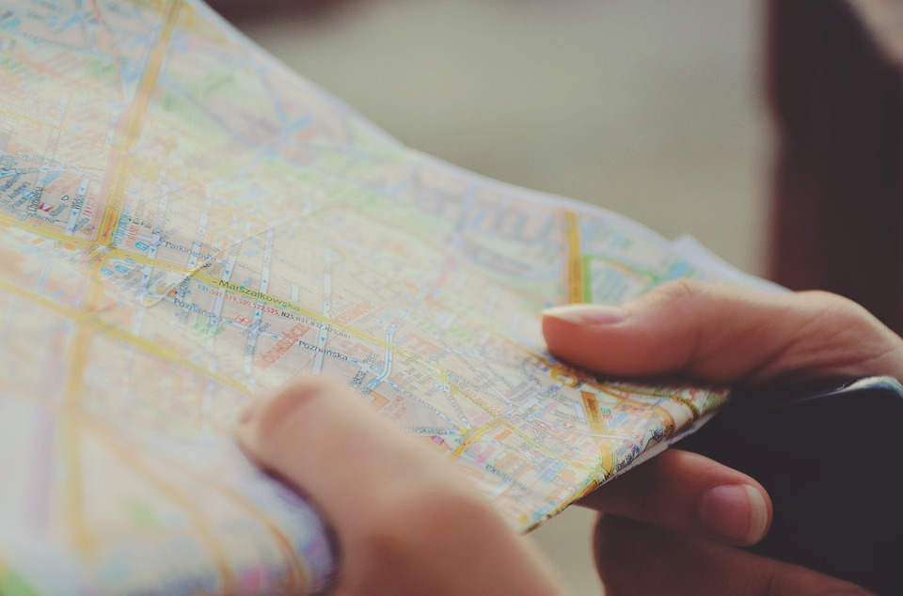
Teach
Look at a map. There are 1,000 metres in 1 kilometre.

Slide 22
Teach
x 1,000
km
m
To convert (change) between m and km, we need to multiply and divide by 1,000.
÷ 1,000

Slide 23
Model
Because we are multiplying and dividing by 1,000 this time, we need to move the digit three spaces to the left or right to make the number 1,000 times larger or smaller.
x 1,000
km
m
÷ 1,000

Slide 24
Model
For example, to find how many km are in 7,530 metres, we need to move the digits three spaces to the right to make the number 1,000 times smaller.
x 1,000
km
m
÷ 1,000
Thousands | Hundreds | Tens | Ones | Tenths | Hundredths | Thousandths
7
5
3
0
Notes:
Click once on slideshow mode to move the digit cards three spaces to the right.

Slide 25
Model
Zeros at the end of a decimal do not change the value of the number, so we can write the answer as just 7.53.
x 1,000
km
m
÷ 1,000
Thousands | Hundreds | Tens | Ones | Tenths | Hundredths | Thousandths
7
5
3
0

Slide 26
Model
So,
7,530m = 7.53km
x 1,000
km
m
÷ 1,000
Thousands | Hundreds | Tens | Ones | Tenths | Hundredths | Thousandths
7
5
3

Slide 27
Apply
x 1,000
x 100
x 10
km
m
m
cm
cm
mm
÷ 1,000
÷ 100
÷ 10
4.5 km = _____m
61.07km = ____m
____km = 234m
____km = 16,000m
70m = _____cm
8.05m = ____cm
____m = 7,000cm
____m = 703.1cm
67cm = _____mm
8.91cm = ____mm
____cm = 58mm
____cm = 93.3mm
Thousands | Hundreds | Tens | Ones | Tenths | Hundredths | Thousandths

Slide 28

Teach
In what units do we measure mass?

Slide 29
Teach
When might we need to measure mass?

Slide 30
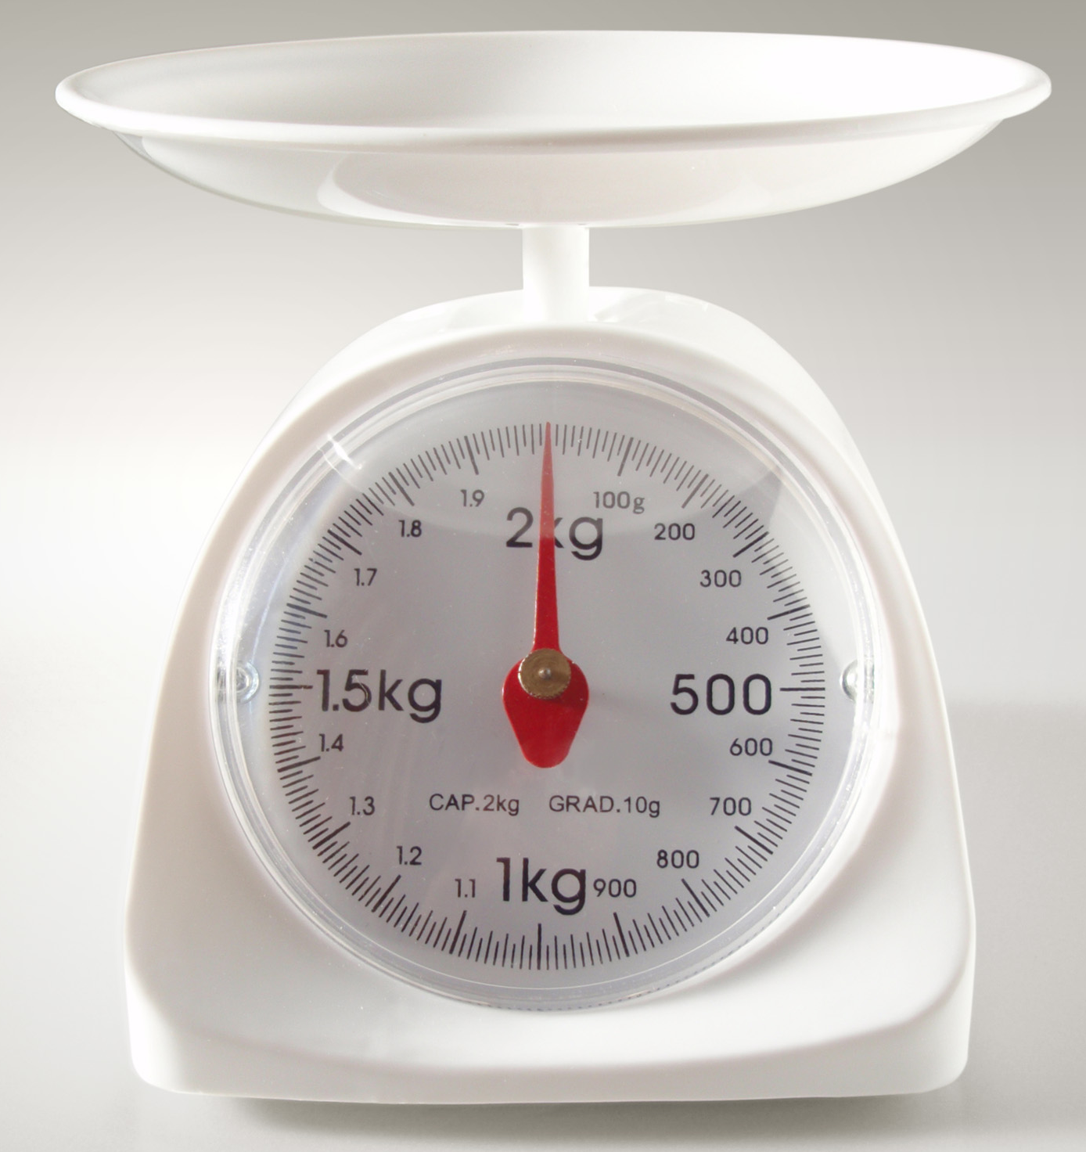
Teach
Look at the kitchen scales. There are 1,000 grams in one kilogram.

Slide 31
Teach
x 1,000
To convert (change) between kg and g, we need to multiply and divide by 1,000.
g
kg
÷ 1,000

Slide 32
Model
Because we are multiplying and dividing by 1,000 this time, we need to move the digit three spaces to the left or right to make the number 1,000 times larger or smaller.
x 1,000
g
kg
÷ 1,000

Slide 33
Model
How many grams are in 3.6kg?
x 1,000
g
kg
÷ 1,000
Thousands | Hundreds | Tens | Ones | Tenths | Hundredths | Thousandths
3
6

Slide 34
Model
How many grams are in 3.6kg?
We need to multiply 3.6kg by 1,000.
x 1,000
kg
g
To do this we move all of the digits 3 places to the left.
÷ 1,000
Thousands | Hundreds | Tens | Ones | Tenths | Hundredths | Thousandths
3
6
Notes:
Click once on slideshow mode to move the digit cards three spaces to the left.

Slide 35
Model
How many grams are in 3.6kg?
x 1,000
We then put zeros as place holders.
We can now see that there are
3,600g in 3.6kg.
kg
g
÷ 1,000
Thousands | Hundreds | Tens | Ones | Tenths | Hundredths | Thousandths
3
6
0
0

Slide 36
Model
How many kilograms are in 7,800g?
x 1,000
g
kg
÷ 1,000
Thousands | Hundreds | Tens | Ones | Tenths | Hundredths | Thousandths
7
8
0
0

Slide 37
Model
How many kilograms are in 7,800g?
We need to divide 7,800g by 1,000.
x 1,000
kg
g
To do this we move all of the digits 3 places to the right.
÷ 1,000
Thousands | Hundreds | Tens | Ones | Tenths | Hundredths | Thousandths
7
8
0
0
Notes:
Click once on slideshow mode to move the digit cards three spaces to the right.

Slide 38
Model
How many kilograms are in 7,800g?
Zeros at the end of a decimal do not change the value of the number, so we don’t need to write them.
We can now see that there are
7.8kg in 7,800g.
x 1,000
kg
g
÷ 1,000
Thousands | Hundreds | Tens | Ones | Tenths | Hundredths | Thousandths
7
8

Slide 39
Apply
Now try some of your own!
Use a place value mat or draw your own to help you.
8.9kg = ____g
16.4kg = ____g
0.87kg = ____g
0.04kg = ____g
8,500g = ____kg
22,550g = ____kg
8,333g = ____kg
9,002g = ____kg
x 1,000
kg
g
Thousands | Hundreds | Tens | Ones | Tenths | Hundredths
÷ 1,000

Slide 40
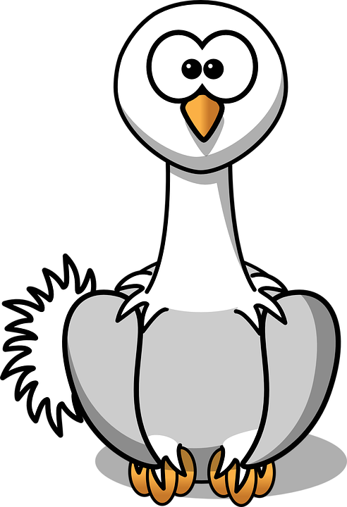
Teach
In what units do we measure capacity?

Slide 41
Teach
When might we need to measure capacity?

Slide 42
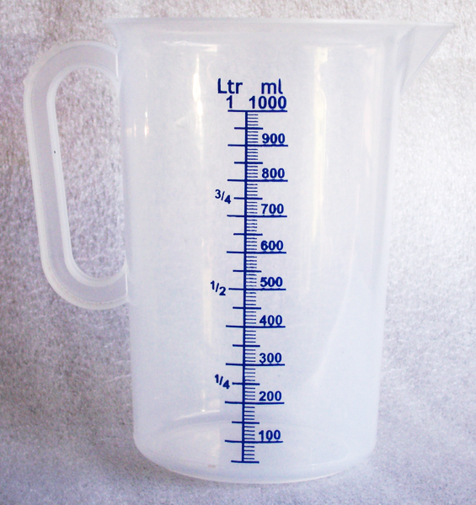
Teach
Look at the measuring jug. There are 1,000 millilitres in one litre.

Slide 43
Teach
x 1,000
To convert (change) between L and ml, we need to multiply and divide by 1,000.
ml
L
÷ 1,000
Notes:
Although both L and l are acceptable abbreviations for litre, the capital letter L is preferred by many as the smaller ‘l’ can look like the number ‘1’ in workings which can lead to confusion and mistakes.

Slide 44
Model
Because we are multiplying and dividing by 1,000 this time, we need to move the digit three spaces to the left or right to make the number 1,000 times larger or smaller.
x 1,000
ml
L
÷ 1,000

Slide 45
Model
This will work in exactly the same way as when we converted between grams and kilograms, as we are multiplying and dividing by 1,000 again, so let’s get stuck straight in with some questions!
x 1,000
ml
L
÷ 1,000

Slide 46
Apply
Now try some of your own!
Use a place value mat or draw your own to help you.
75,000ml = ____L
890ml = ____L
4,343ml = ____L
5,006ml = ____L
23L = ____ml
6.8L = ____ml
45.8L = ____ml
2.01L = ____ml
x 1,000
ml
L
Thousands | Hundreds | Tens | Ones | Tenths | Hundredths
÷ 1,000

Slide 47
Model
We can use our knowledge of converting to answer reasoning questions.

Slide 48
Model
I pour 250ml from a jug containing 1 litre of milk. How much do I have left?

Slide 49
Model
1,000ml
I pour 250ml from a jug containing 1 litre of milk. How much do I have left?
First, we make sure the question is all written in the same units.
1 litre = 1,000ml

Slide 50
Model
1,000ml
I pour 250ml from a jug containing 1 litre of milk. How much do I have left?
1,000ml – 250ml = 750ml
Then, we can work out the word problem.
750ml of milk is left.

Slide 51
Apply
I cut three lengths of 40 centimetres from a piece of ribbon that measures 2 metres. How much ribbon do I have left over?

Slide 52
Apply
I cut three lengths of 40 centimetres from a piece of ribbon that measures 2 metres. How much ribbon do I have left over?
200 centimetres
First, we make sure the question is all written in the same units.
1 metre = 100 centimetres
2 metres = 200 centimetres

Slide 53
Apply
I cut three lengths of 40 centimetres from a piece of ribbon that measures 2 metres. How much ribbon do I have left over?
200 centimetres
Ribbon used: 40cm x 3 = 120cm
Then, we can work out the word problem.
Ribbon left: 200cm – 120cm = 80cm

Slide 54


Evaluate
Can you convert between metric units of length?

Slide 55
Evaluate
Can you convert between metric units of mass?

Slide 56
Evaluate
Can you convert between metric units of capacity?

