Slide 1


.
Y5 M5b Can understand and use equivalence between metric and imperial units of measure, such as inches, pounds and pints
Commissioned by The PiXL Club Ltd.
November 2019
This resource is strictly for the use of member schools for as long as they remain members of The PiXL Club. It may not be copied, sold nor transferred to a third party or used by the school after membership ceases. Until such time it may be freely used within the member school.
All opinions and contributions are those of the authors. The contents of this resource are not connected with nor endorsed by any other company, organisation or institution.
PiXL Club Ltd endeavour to trace and contact copyright owners. If there are any inadvertent omissions or errors in the acknowledgements or usage, this is unintended and PiXL will remedy these on written notification.
© Copyright The PiXL Club Limited, 2019

Slide 2
Teachers’ Notes
The PiXL therapies can be taught to a whole class or a target group. Year 3-5 therapies are designed to take approximately 30-40 minutes. However, this is flexible: it may be that only part of the therapy is taught or it could, of course, be adapted or extended.
Each therapy begins with a LORIC activity to develop relevant learning behaviours.
This is followed by a vocabulary task, which uses the PiXL 5-phase approach to teach key mathematical vocabulary. Further resources to develop vocabulary can be found in the Whole School area.
Each therapy adopts the ‘Teach, model and apply’ process with opportunities for pupils to demonstrate the taught skill independently.
Problem solving and reasoning activities are an integral part of each therapy.

Slide 3
Progress across amber – the 4-stage model
The three therapy tests which accompany this resource can be used to revisit the taught skill to check that the pupil is able to perform it independently and consistently.
A
A child has successfully completed a therapy test independently, following a set of therapy sessions.
A child has successfully completed a therapy test independently, a period after the relevant therapy sessions – we would advise about 2 weeks.
A child has successfully applied their knowledge or skill in an unfamiliar context. This may be application across the curriculum or in a problem.
A pupil has successfully re-visited the skills at a later point, and applies these in an unfamiliar context or problem, or across the curriculum.
A
DA
G

Slide 4
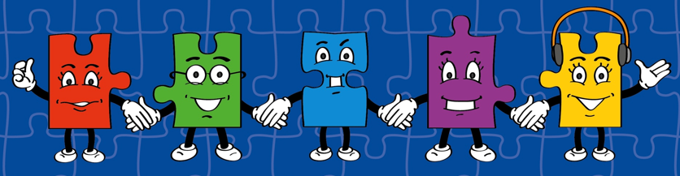
LORIC task
Our Primary Edge attributes help us to become better learners and today is no exception. Before you start this activity, here are some ideas for how you will need your Charlie Communication skills today:
Speak clearly
Discuss ideas by taking turns
Listen well

Slide 5


LORIC task
Today we are going to debate a range of different
statements.
Remember our rules for speaking and listening in groups.
Debate examples to include:
Pounds can be used as a measure of weight.
Imperial units of measure are not used nowadays.

Slide 6
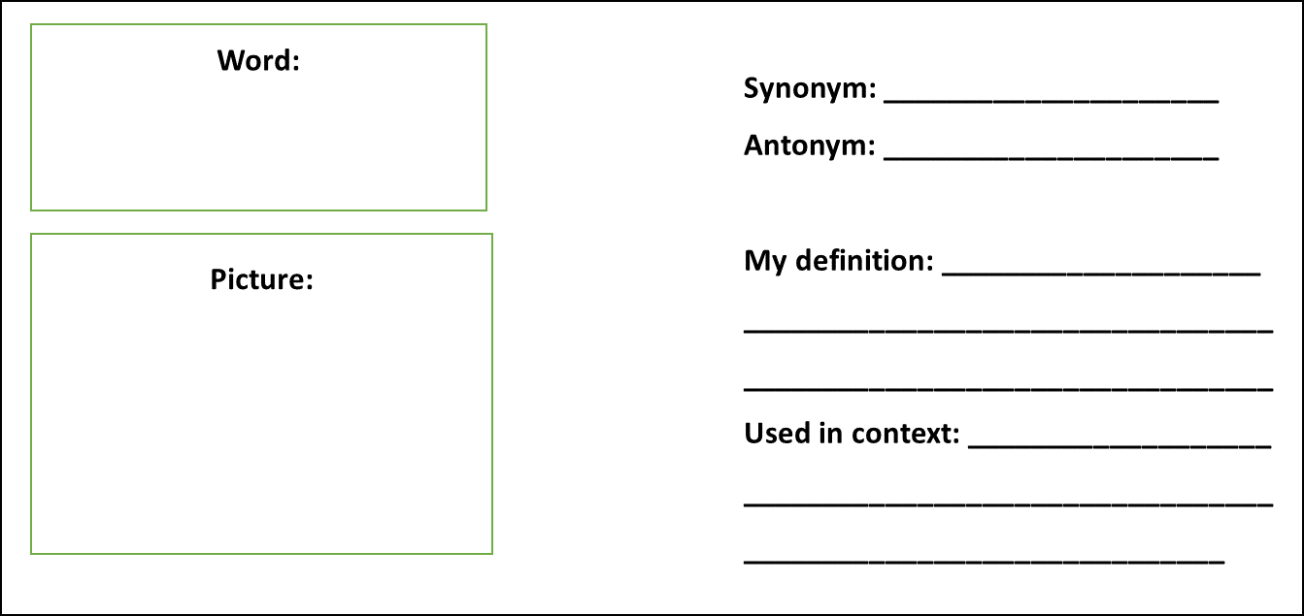
Vocabulary activity
equivalence
metric imperial
DEFINE IT / USE IT

Slide 7
Teach
To look at the equivalence between metric and imperial units of measure, we need to understand the difference.
Metric
We normally measure length, mass and capacity in metric measures nowadays. It is easier to understand as it deals with tens, hundreds and thousands.
Imperial
Imperial measures are the old units of measure, used frequently in the past. These are not now commonly used in mathematics.

Slide 8
Teach
Today, we are going to look at the equivalence between metric and imperial units of measure.
To do this, we also need to recap on our knowledge of metric measures:
Length | Mass | Capacity
1cm (centimetre) = 10mm (millimetre) 1m (metre) = 100cm or 1,000mm 1km (kilometre) = 1,000m | 1g (gram) = 10mg (milligram) 1kg (kilogram) = 1,000g | 1cl (centilitre) = 10ml (millilitre) 1l (litre) = 1,000ml or 100cl

Slide 9
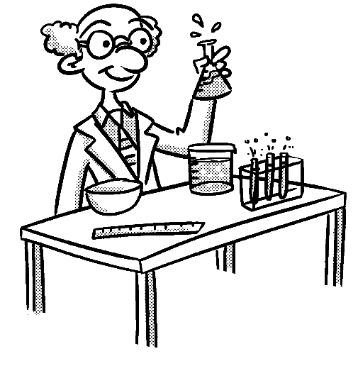
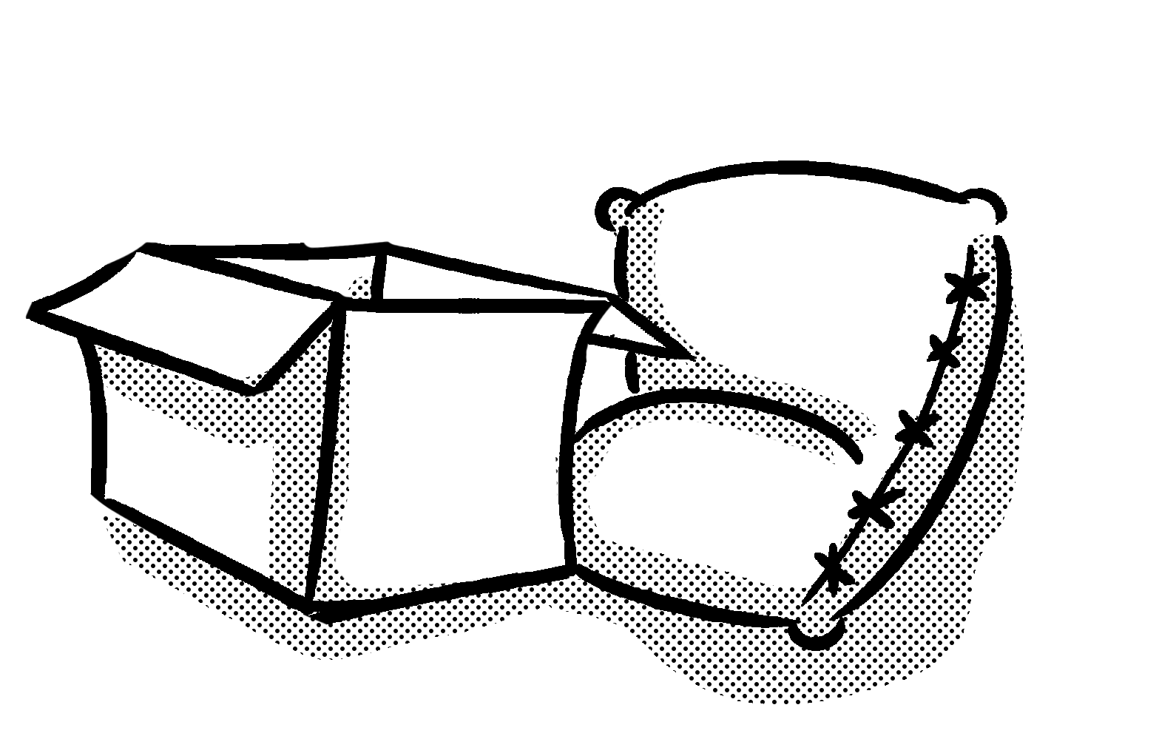
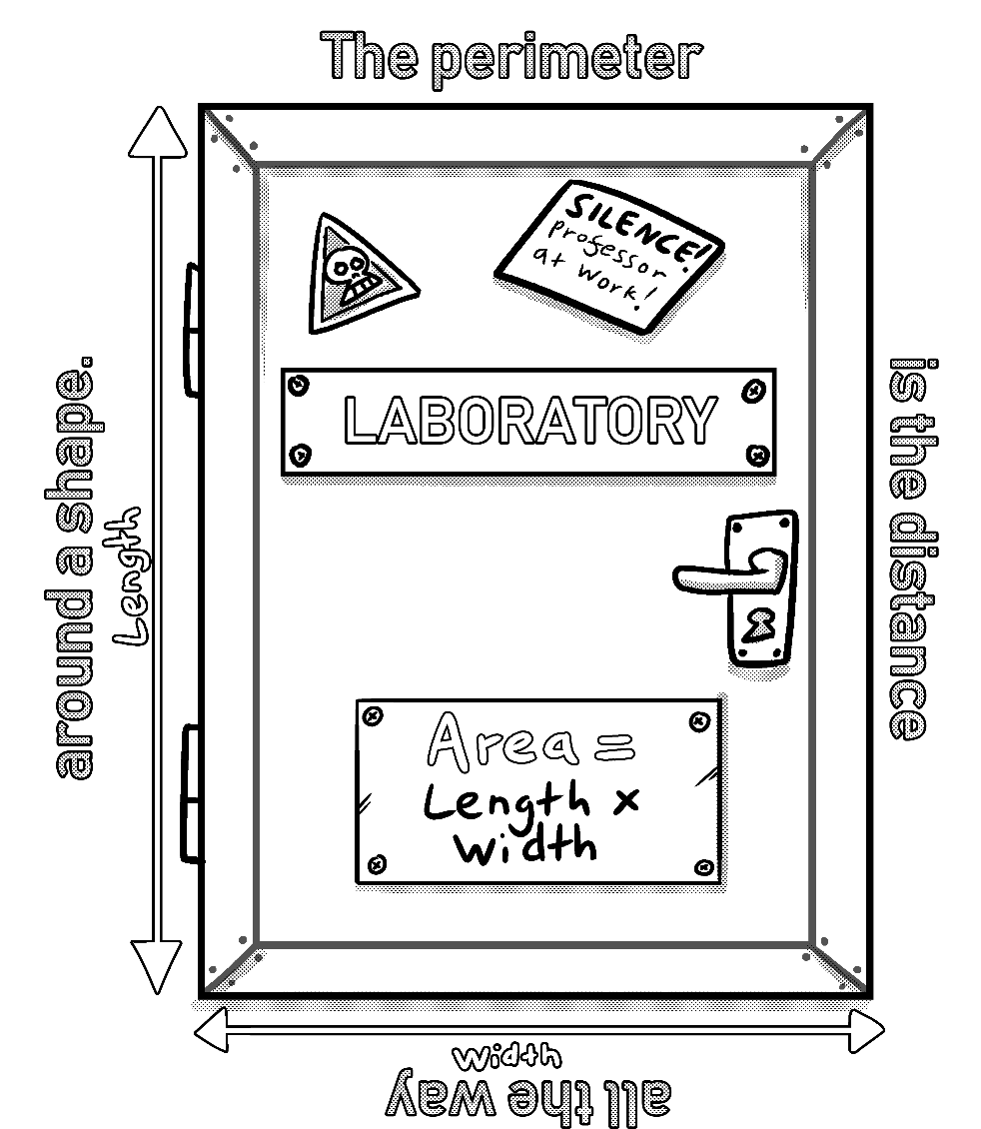
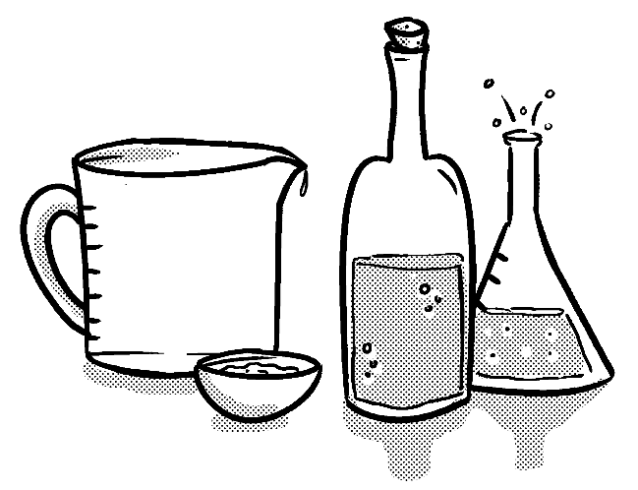
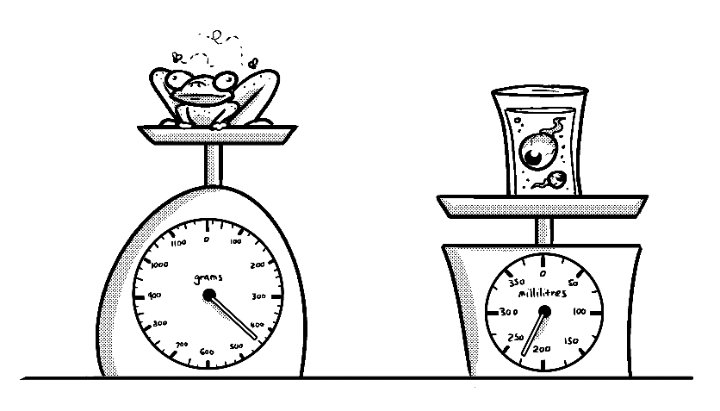
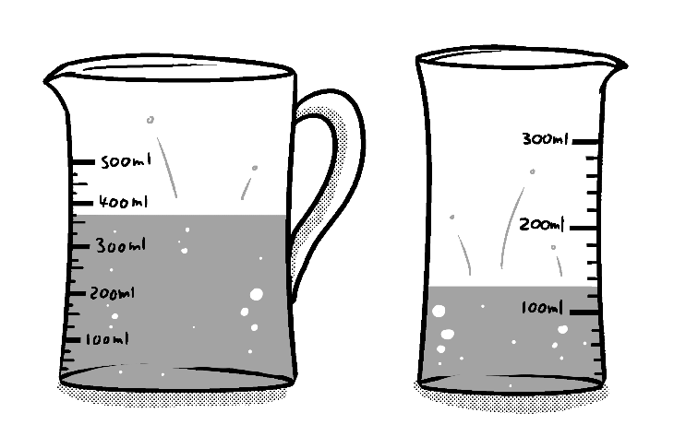
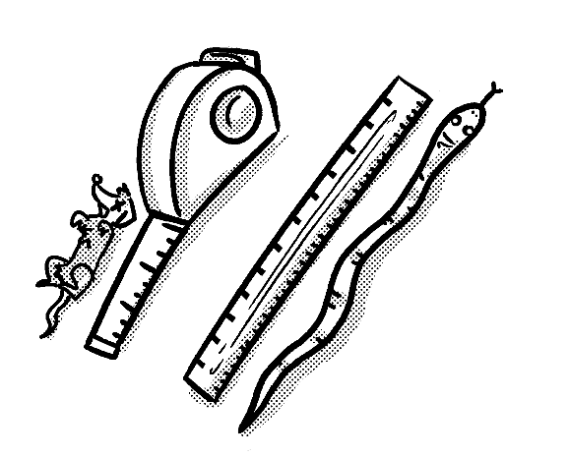

Primary Maths Measures – Years 5 and 6
Mass
1,000 grams (g) = 1 kilograms (kg)
Capacity
1,000 millilitres (ml) = 1 litre (l)
Length
10 millimetres (mm) = 1 centimetre (cm)
100 centimetres (cm) = 1 metre (m)
1,000 metres (m) = 1 kilometre (km)
© November 2018 The PiXL Club Ltd. All rights reserved.
This resource is strictly for the use of member schools for as long as they remain members of The PiXL Club Ltd.
Notes:
PiXL Knowledge Mats can be a good support for this therapy.

Slide 10
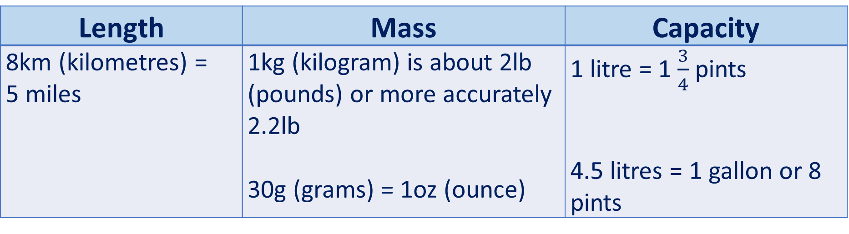
Teach
To look at the equivalence between metric and imperial units of measure, we need to know some key facts.
Length | Mass | Capacity
8km (kilometres) = 5 miles | 1kg (kilogram) is about 2lb (pounds) or more accurately 2.2lb 30g (grams) = 1oz (ounce) | 1 litre = 1 $\frac{3}{4}$ pints 4.5 litres = 1 gallon or 8 pints

Slide 11
Model
LENGTH: How many miles are there in 24km?
To work this problem out, I need to recall the equivalent length of kilometres (km) to miles.
LENGTH: 8km (kilometres) = 5 miles.
I know that
8km + 8km + 8km = 24km
I can check this by doing the following calculation:
24km ÷ 8km = 3
8 | 8 | 8
24

Slide 12
Model
LENGTH: How many miles are there in 24km?
LENGTH: 8km (kilometres) = 5 miles.
24km ÷ 8km = 3
This means I need to work out
3 x 5 as I know that 8km = 5 miles and there are 3 lots of 8km in 24km.
The answer is 15 miles.
Using the bar model method, I can work out the equivalent answer in km and in miles.
8 | 8 | 8
5 | 5 | 5
24

Slide 13
Apply (Length)
REMEMBER: 8km (kilometres) = 5 miles
Work out the equivalent measure for the following:
88km = ______ miles
65 miles = ______ km
48km = ______ miles

Slide 14
Model
MASS: How many lb (pounds) in 6kg?
To work this problem out, I need to recall the equivalent mass of kilograms (kg) to pounds (lb).
MASS: 1kg = 2.2lb (pounds).
2.2lb | 2.2lb | 2.2lb | 2.2lb | 2.2lb | 2.2lb
1kg | 1kg | 1kg | 1kg | 1kg | 1kg
6kg

Slide 15
Model
MASS: How many lb (pounds) in 6kg?
Using the bar model and my knowledge that 1kg = 2.2lb, I can work out how many lbs are in 6kg.
2.2lb | 2.2lb | 2.2lb | 2.2lb | 2.2lb | 2.2lb
1kg | 1kg | 1kg | 1kg | 1kg | 1kg
6kg
I could also work this out using the calculation 2.2 x 6 = 13.2
The answer is 6kg = 13.2lb
Notes:
Can also show a strategy for 2.2 lbs x 6 by partitioning into 2 x 6 and then 0.2 x 6

Slide 16
Apply (Mass)
REMEMBER: 1 kilogram (kg) = 2.2 pounds (lb)
Work out the equivalent measure for the following:
22lb = ______ kg
9kg = ______ lb
26.4 lb = ______ kg

Slide 17
Model
CAPACITY: How many pints in 4 litres?
To work this problem out, I need to recall the equivalent capacity of litres (l) to pints.
CAPACITY: 1 litre = 1.75 pints
I know that I need to complete the following calculation:
1.75 x 4 = 7 pints.
I can check this with repeated addition if I want.
The answer is 4 litres = 7 pints
1l | 1l | 1l | 1l
1.75 | 1.75 | 1.75 | 1.75
4l
Notes:
Can also show a strategy for 1.75l x 4 by partitioning into 1 x 4 and then 0.75 x 4

Slide 18
Apply (Capacity)
REMEMBER: 1 litre (l) = 1.75 pints
Work out the equivalent measure for the following:
10l = ______ pints
5.25 pints = ______ l
6l = ______ pints

Slide 19
Apply – Problem Solving
Lewis runs 10 miles on a Saturday and 10 miles on a Sunday.
How far does he run in total?
Give your answer in kilometres.

Slide 20
Apply – Problem Solving
Sean has 2kg of flour and 1kg of sugar. How much does he have altogether? Give your answer in pounds (lb).

Slide 21
Apply – Problem Solving
Kiera drinks 8.75 pints of water over 2 days.
How much does she drink in litres?

Slide 22


Apply – Reasoning
Container A has 14 litres of water.
Container B has 22.75 pints of water.
Callum says there is more water in container B.
Is he correct?
Explain your reasoning.
A
B

Slide 23
Apply – Reasoning
Tom says that 22lb is the same as 10kg.
Is he correct?
Explain your reasoning.

