Slide 1


.
Y5 M5c Can measure and calculate the perimeter of composite rectilinear shapes, including squares
Commissioned by The PiXL Club Ltd.
November 2019
This resource is strictly for the use of member schools for as long as they remain members of The PiXL Club. It may not be copied, sold nor transferred to a third party or used by the school after membership ceases. Until such time it may be freely used within the member school.
All opinions and contributions are those of the authors. The contents of this resource are not connected with nor endorsed by any other company, organisation or institution.
PiXL Club Ltd endeavour to trace and contact copyright owners. If there are any inadvertent omissions or errors in the acknowledgements or usage, this is unintended and PiXL will remedy these on written notification.
© Copyright The PiXL Club Limited, 2019

Slide 2
Teachers’ Notes
The PiXL therapies can be taught to a whole class or a target group. Year 3-5 therapies are designed to take approximately 30-40 minutes. However, this is flexible: it may be that only part of the therapy is taught or it could, of course, be adapted or extended.
Each therapy begins with a LORIC activity to develop relevant learning behaviours.
This is followed by a vocabulary task, which uses the PiXL 5-phase approach to teach key mathematical vocabulary. Further resources to develop vocabulary can be found in the Whole School area.
Each therapy adopts the ‘Teach, model and apply’ process with opportunities for pupils to demonstrate the taught skill independently.
Problem solving and reasoning activities are an integral part of each therapy.

Slide 3
Progress across amber – the 4-stage model
The three therapy tests which accompany this resource can be used to revisit the taught skill to check that the pupil is able to perform it independently and consistently.
A
A child has successfully completed a therapy test independently, following a set of therapy sessions.
A child has successfully completed a therapy test independently, a period after the relevant therapy sessions – we would advise about 2 weeks.
A child has successfully applied their knowledge or skill in an unfamiliar context. This may be application across the curriculum or in a problem.
A pupil has successfully re-visited the skills at a later point, and applies these in an unfamiliar context or problem, or across the curriculum.
A
DA
G

Slide 4


LORIC task
The LORIC task will focus on your Raj Resilience skills today:
Do not be put off by a difficult task
Keep going – persevere
Think about ways you can help yourself and others

Slide 5

LORIC task
Using any of the numbers 1-9 only once,
work out the multiplication calculation which
will give the answer closest to 2,500.
E.g. 82 x 19 = 1,558.
?
?
x
?
?

Slide 6
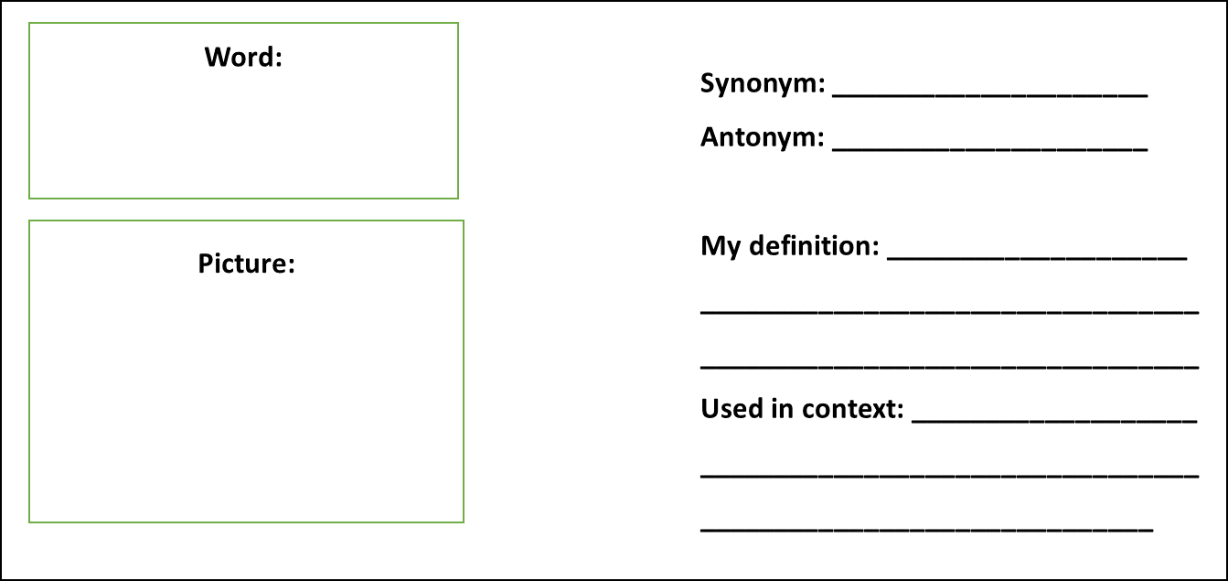
Vocabulary activity
perimeter
measure
composite
length
width
DEFINE IT / USE IT

Slide 7
Teach
Today, we are going to calculate the perimeter of rectangular shapes, including squares.
The perimeter of a shape is the distance around the edge of the shape. For example, the distance around the edge of a playing field or the distance around a given object.
width
length

Slide 8
Teach
To find the perimeter we need to add all the measurements from around the outside.
To calculate the perimeter of a square, I need to add all the sides of the shape.
I only need to know the length of one side as all sides will be the same length.
5cm + 5cm + 5cm + 5cm = 20cm (or 4 x 5 = 20cm)
The perimeter of this square is 20cm.
5cm
.

Slide 9
Teach
The perimeter of a shape is the distance around the edge of the shape. For example, the distance around the edge of a playing field or the distance around a given object.
width
A composite rectilinear shape is one that is made up of two or more rectangular shapes.
length

Slide 10
Teach
To find the perimeter, we need to add all the measurements from around the outside.
3cm
To calculate the perimeter of this shape, I need to add all the sides of the shape.
10cm + 7cm + 3cm + 2cm + 7cm + 5cm = 34cm.
The perimeter of this shape is 34cm.
2cm
7cm
7cm
5cm
10cm

Slide 11
Model
To work out the perimeter of this shape, I need to add all the sides of the shape. I can see some are missing.
4cm
The calculation so far is:
9cm + 8cm + 4cm + ?cm + ?cm + 4cm
?
8cm
?
To work out the missing numbers, I need to use my knowledge of the rest of the shape.
4cm
9cm

Slide 12
Model
The calculation so far is: 9cm + 8cm + 4cm + ?cm + ?cm + 4cm
I know I can work out this missing length using the following calculation:
4cm + _____ = 9cm.
4cm
?
5cm
8cm
This means the missing length is 5cm.
I can check this using the inverse:
9cm – 4cm = 5cm.
4cm
9cm

Slide 13
Model
The calculation so far is: 9cm + 8cm + 4cm + ?cm + 5cm + 4cm
I know I can work out this missing width using the following calculation. I know that 8cm – 4cm = 4cm.
4cm
4cm
8cm
5cm
The final calculation is: 9cm + 8cm + 4cm + 4cm + 5cm + 4cm = 34cm
The perimeter is 34cm.
4cm
9cm

Slide 14
Apply
Calculate the perimeter of each shape:
?
9cm
4cm
6cm
?
?
10cm
3cm
3cm
?
2cm
?
8cm
5cm

Slide 15
Model
The perimeter of one square is 20cm.
To work out the perimeter of the entire shape, I need to use the information provided.
If the perimeter of one square is 20cm, I need to divide that by 4 to work out the length of one side.
The calculation I need to complete is:
20cm ÷ 4 = 5cm.
The perimeter of one side is 5cm.

Slide 16
Model
Now I know that each side is 5cm in length, I can calculate the perimeter of the complete shape.
1
2
12
3
I have counted 12 sides of the square in total.
That means I need to calculate 12 x 5cm.
11
10
4
9
8
5
12cm x 5cm = 60cm
The perimeter of the shape is 60cm.
7
6

Slide 17
Apply
The perimeter of one square is 24cm.
What is the perimeter of the whole shape?

Slide 18
Apply – Problem Solving
11m
Mr Jones wants to lay a patio around the outside of his garden. He knows the total perimeter is 38m.
What are the missing dimensions?
8m
5m
6m

Slide 19
Apply – Problem Solving
The perimeter of the shape is 36cm.
What is the length of one side of a square?

Slide 20
Apply – Reasoning
The length of one side of shape A is 8cm.
The length of one square in shape B is 4cm.
Ally says both shapes have the same perimeter. Is she correct? Explain how you know.
A
B

