Slide 1


.
Y5 M5d Can measure and calculate the area of a rectangle, including a square
Commissioned by The PiXL Club Ltd.
November 2019
This resource is strictly for the use of member schools for as long as they remain members of The PiXL Club. It may not be copied, sold nor transferred to a third party or used by the school after membership ceases. Until such time it may be freely used within the member school.
All opinions and contributions are those of the authors. The contents of this resource are not connected with nor endorsed by any other company, organisation or institution.
PiXL Club Ltd endeavour to trace and contact copyright owners. If there are any inadvertent omissions or errors in the acknowledgements or usage, this is unintended and PiXL will remedy these on written notification.
© Copyright The PiXL Club Limited, 2019

Slide 2
Teachers’ Notes
The PiXL therapies can be taught to a whole class or a target group. Year 3-5 therapies are designed to take approximately 30-40 minutes. However, this is flexible: it may be that only part of the therapy is taught or it could, of course, be adapted or extended.
Each therapy begins with a LORIC activity to develop relevant learning behaviours.
This is followed by a vocabulary task, which uses the PiXL 5-phase approach to teach key mathematical vocabulary. Further resources to develop vocabulary can be found in the Whole School area.
Each therapy adopts the ‘Teach, model and apply’ process with opportunities for pupils to demonstrate the taught skill independently.
Problem solving and reasoning activities are an integral part of each therapy.

Slide 3
Progress across amber – the 4-stage model
The three therapy tests which accompany this resource can be used to revisit the taught skill to check that the pupil is able to perform it independently and consistently.
A
A child has successfully completed a therapy test independently, following a set of therapy sessions.
A child has successfully completed a therapy test independently, a period after the relevant therapy sessions – we would advise about 2 weeks.
A child has successfully applied their knowledge or skill in an unfamiliar context. This may be application across the curriculum or in a problem.
A pupil has successfully re-visited the skills at a later point, and applies these in an unfamiliar context or problem, or across the curriculum.
A
DA
G

Slide 4

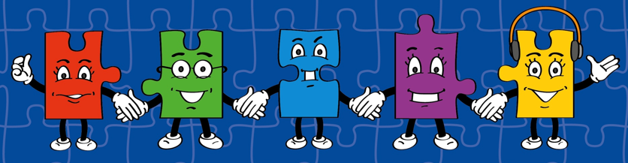
LORIC task
Our Primary Edge attributes help us to become better learners and today is no exception. Before you start this activity, here are some ideas for how you will need your Raj Resilience skills today:
Do not be put off by a difficult task
Keep going – persevere
Think about ways you can help yourself and others

Slide 5

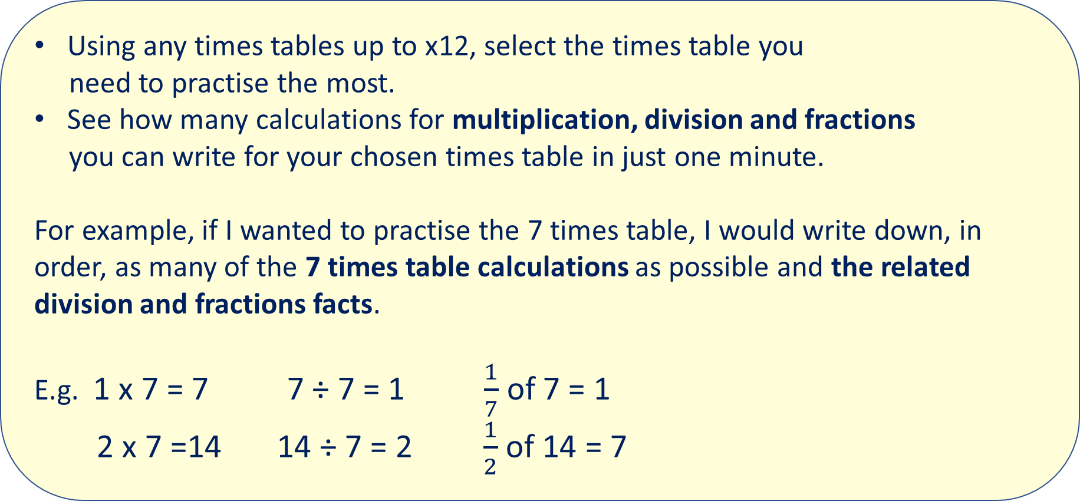
LORIC task
Using any times tables up to x12, select the times table you
need to practise the most.
See how many calculations for multiplication, division and fractions
you can write for your chosen times table in just one minute.
For example, if I wanted to practise the 7 times table, I would write down, in order, as many of the 7 times table calculations as possible and the related division and fractions facts.
E.g. 1 x 7 = 7 7 ÷ 7 = 1 $\frac{1}{7}$ of 7 = 1
2 x 7 =14 14 ÷ 7 = 2 $\frac{1}{2}$ of 14 = 7

Slide 6
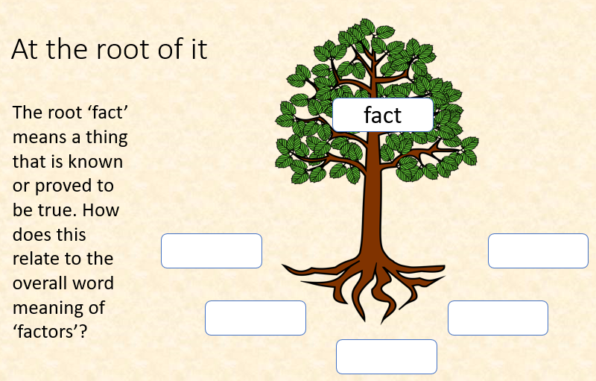
Vocabulary activity
area
width
length
factors
DECONSTRUCT IT

Slide 7
Teach
Today, we are going to calculate the area of rectangles, including squares.
The area of a shape is the surface space taken up by that shape.
For example, the area of a playing field or a given object is the total surface space taken up by the field or object.
width
length

Slide 8
Teach
Today, we are going to calculate the area of shapes by using the formula: length x width = area
The unit we use when calculating area is mm² cm² or m².
4cm x 6cm =
24cm²
4cm
6cm

Slide 9
Teach
Today, we are going to calculate the area of shapes by using the formula: length x width = area
When calculating the area of a square, each side is the same measurement.
7cm x 7cm = 49cm²
7cm

Slide 10
Model
We can calculate the area of this shape simply by multiplying the length by the width.
This means I need to complete the following calculation:
5cm x 9cm = 45cm²
or 9cm x 5cm = 45cm²
5cm
9cm
The answer is 45cm² (we read this as ‘45 square centimetres’).

Slide 11
Model
We can calculate the area of this shape by using the formula:
length x width = area
This shape is a square, which means I need to complete the following calculation:
9m x 9m = 81m²
The answer is 81m² (we read this as ‘81 square metres’).
9m

Slide 12
Apply
Work out the area of each shape. Give each answer in cm²:
3cm
5cm
7cm
8cm
2cm
12cm

Slide 13
Model
If I had to create a shape with a given area, I would need to use my knowledge of factors to help me.
For example, if I had to create a shape with an area of 12cm^{2,} I would use the following factor pairs: (1 and 12), (2 and 6), (3 and 4).
1cm
2cm
3cm
12cm
6cm
4cm

Slide 14
Your Turn
Use your knowledge of factor pairs to find all the possible dimensions for rectangles with the following areas:
36cm²
72cm²
120cm²

Slide 15
Apply – Problem Solving
Jenny has a rectangular garden measuring 4m by 12m.
In m², what is the area of her garden?
4m
12m

Slide 16
Apply – Problem Solving
Which shapes have an area of 36cm²?
A
B
C
3cm
5cm
12cm
7cm
6cm

Slide 17
Apply – Problem Solving
Draw and label a rectangle with an area of 30cm².
(Think about your knowledge of factor pairs of 30.)
Challenge: Can you find more than one way of showing this area?

Slide 18
Apply – Reasoning
Mark says the area of this square is 20cm²
Is he correct?
Explain how you know.
4cm

