Slide 1


.
Y5 M5f Can estimate volume
Commissioned by The PiXL Club Ltd.
November 2019
This resource is strictly for the use of member schools for as long as they remain members of The PiXL Club. It may not be copied, sold nor transferred to a third party or used by the school after membership ceases. Until such time it may be freely used within the member school.
All opinions and contributions are those of the authors. The contents of this resource are not connected with nor endorsed by any other company, organisation or institution.
PiXL Club Ltd endeavour to trace and contact copyright owners. If there are any inadvertent omissions or errors in the acknowledgements or usage, this is unintended and PiXL will remedy these on written notification.
© Copyright The PiXL Club Limited, 2019

Slide 2
Teachers’ Notes
The PiXL therapies can be taught to a whole class or a target group. Year 3-5 therapies are designed to take approximately 30-40 minutes. However, this is flexible: it may be that only part of the therapy is taught or it could, of course, be adapted or extended.
Each therapy begins with a LORIC activity to develop relevant learning behaviours.
This is followed by a vocabulary task, which uses the PiXL 5-phase approach to teach key mathematical vocabulary. Further resources to develop vocabulary can be found in the Whole School area.
Each therapy adopts the ‘Teach, model and apply’ process with opportunities for pupils to demonstrate the taught skill independently.
Problem solving and reasoning activities are an integral part of each therapy.
This therapy lends itself to practical activities. This is an introduction to the topic but hands-on, practical activities with a range of tasks (E.g. Unifix cubes etc.) will be essential to developing a secure understanding.

Slide 3
Progress across amber – the 4-stage model
The three therapy tests which accompany this resource can be used to revisit the taught skill to check that the pupil is able to perform it independently and consistently.
A
A child has successfully completed a therapy test independently, following a set of therapy sessions.
A child has successfully completed a therapy test independently, a period after the relevant therapy sessions – we would advise about 2 weeks.
A child has successfully applied their knowledge or skill in an unfamiliar context. This may be application across the curriculum or in a problem.
A pupil has successfully re-visited the skills at a later point, and applies these in an unfamiliar context or problem, or across the curriculum.
A
DA
G

Slide 4

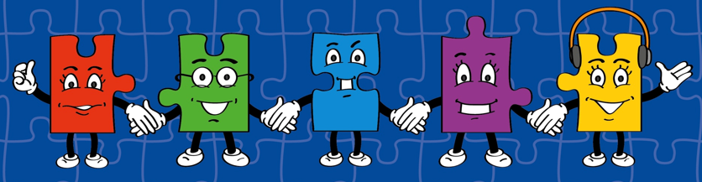
LORIC task
The LORIC task will focus on your Raj Resilience skills today:
Do not be put off by a difficult task
Keep going – persevere
Think about ways you can help yourself and others

Slide 5

LORIC task
Using any of the numbers 1-9 only once, find the closest answer to 150.
x
x
=

Slide 6
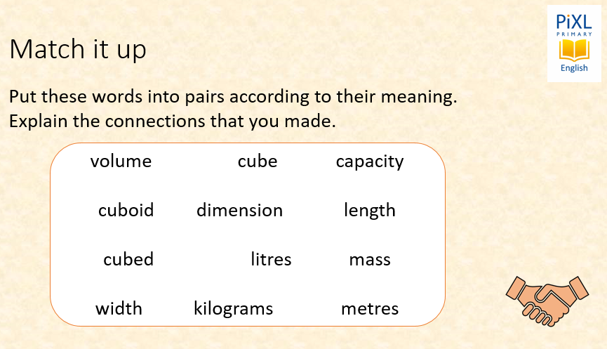
Vocabulary activity
volume
cubed
cube
cuboid
dimensions
LINK IT

Slide 7
Teach
Today, we are going to estimate volume.
The volume of a cube, cuboid or other 3-D shape is the space taken up by that shape. For example, the volume of a box is the total space taken up by that box.
Volume is measured in cubes.
Estimate means to give a rough answer that may be a little less or a little more than the actual result.

Slide 8
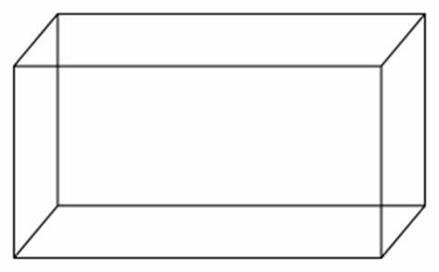
Teach
Today, we are going to estimate volume.
A three-dimensional (3-D) shape can be defined as a solid figure, object or shape that has three dimensions – length, width and height.
length
width
height

Slide 9
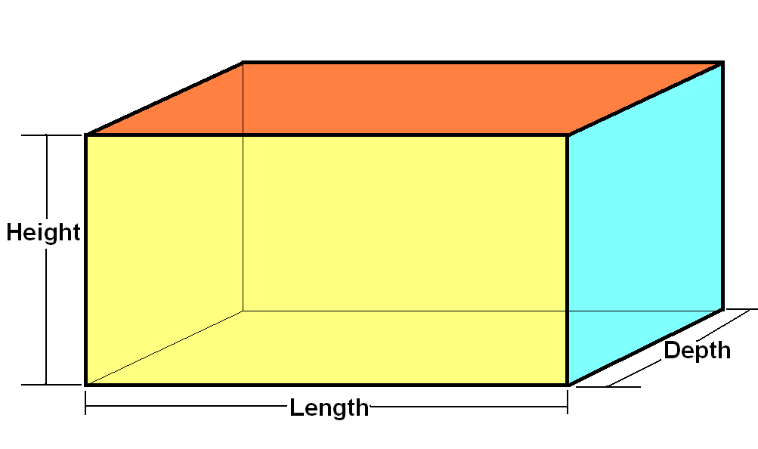
Teach
Today, we are going to estimate volume.
The volume of a cube, cuboid or other 3-D shape can also be described in this way too.

Slide 10
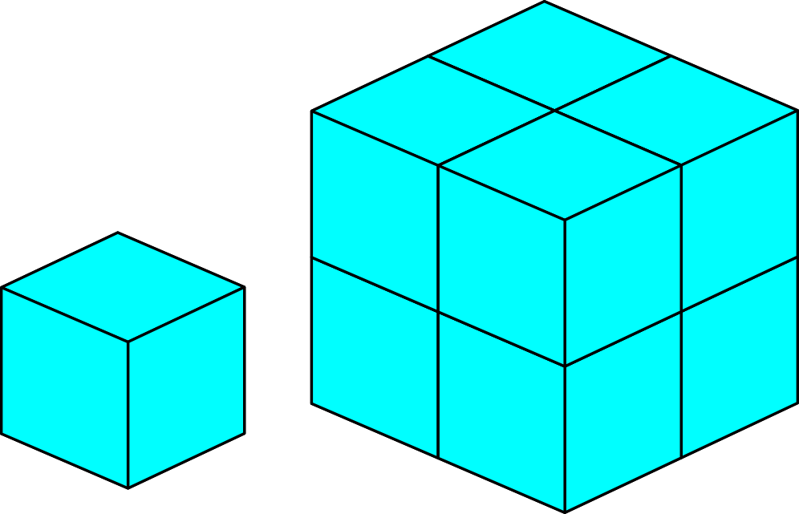
Teach
Today, we are going to estimate volume.
The volume of a cube, cuboid or other 3-D shape is the space taken up by that shape. For example, the volume of a box is the total space taken up by that box.
Volume is measured in cubes.
This cube has a volume of 1cm³
(1 centimetre cubed).

Slide 11
Teach
The volume of a cube, cuboid or other 3-D shape is the space taken up by that shape. Volume is measured in cubes.
We can calculate volume by counting cubes.
We can see that this cube has a volume of 8cm³.

Slide 12
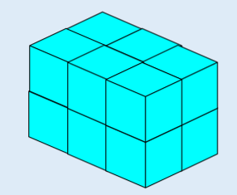
Model
I can estimate the volume of this cuboid.
I can estimate the volume simply by counting the cubes.
Counting each cube is a helpful strategy to estimate the area. I can count 6 on the top layer. I know this means there are 6 on the bottom layer too.
I have counted all the cubes and estimate that the volume of this cuboid is 12cm³.

Slide 13
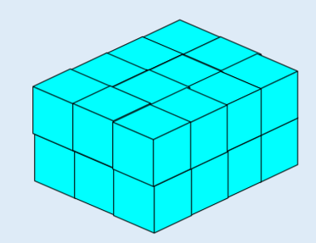
Model
I can estimate the volume simply by counting the cubes.
Counting each cube is a helpful strategy to estimate the volume. I can count 12 on the top layer. I know this means there are 12 on the bottom layer too.
I have counted all the cubes and estimate that the volume of this cuboid is 24cm³.

Slide 14
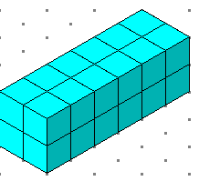
Model
I can estimate the volume of this cuboid even though some of the shape is missing. I can estimate the volume simply by counting the cubes.
Counting each cube is a helpful strategy to estimate the volume. I can see 10 cubes on the top layer. But I also know there are some missing.
I estimate that a further 2 cubes are being covered up. This would mean a total of 12 in one layer.

Slide 15
Model
As I know there are 12 on the top layer, there must be the same number on the bottom layer too. This means I can estimate the volume.
I estimate that the volume of this cuboid is
2 x 12 = 24cm³.

Slide 16
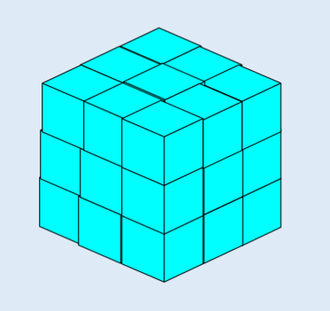
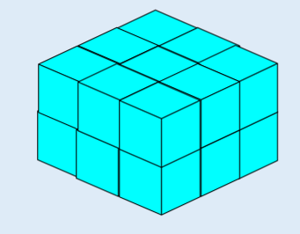
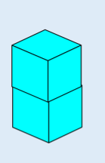
Apply
Estimate the volume of each shape. Give each answer in cm³:
A
B
C

Slide 17
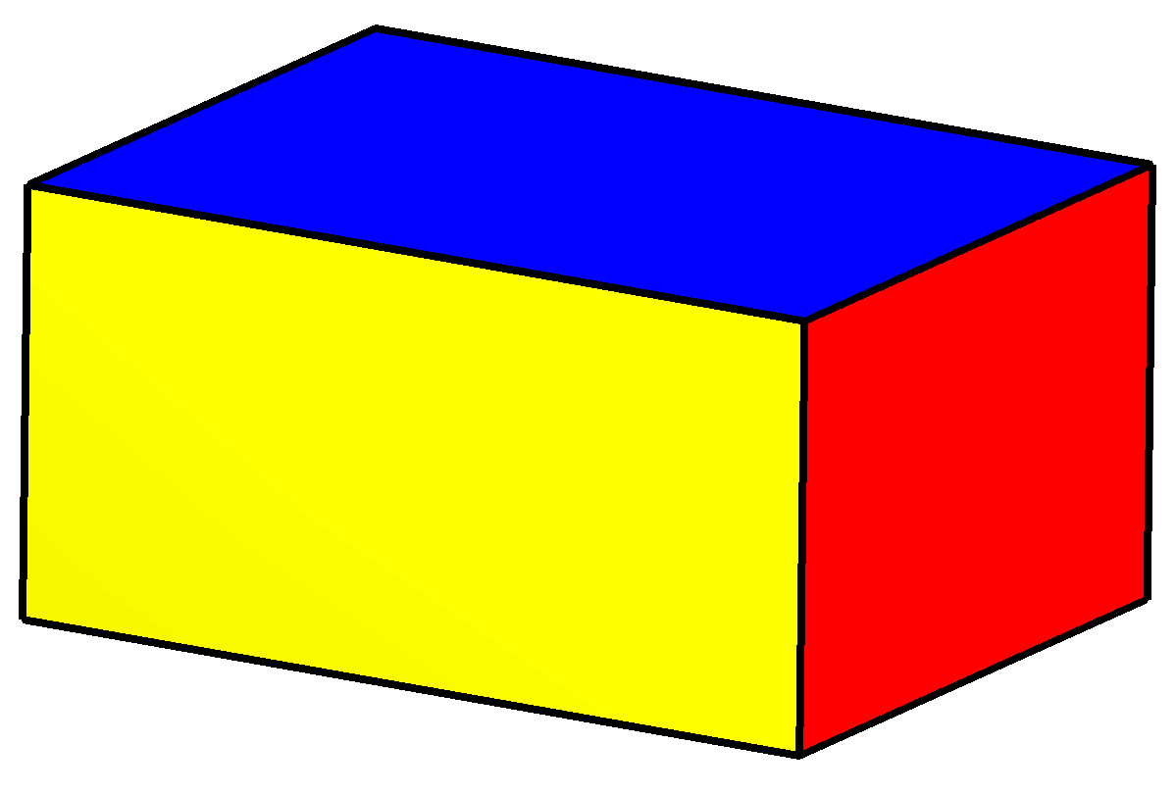
Apply – Problem Solving
Label the following cuboid with the dimensions needed to work out volume.

Slide 18
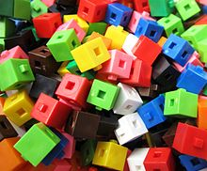
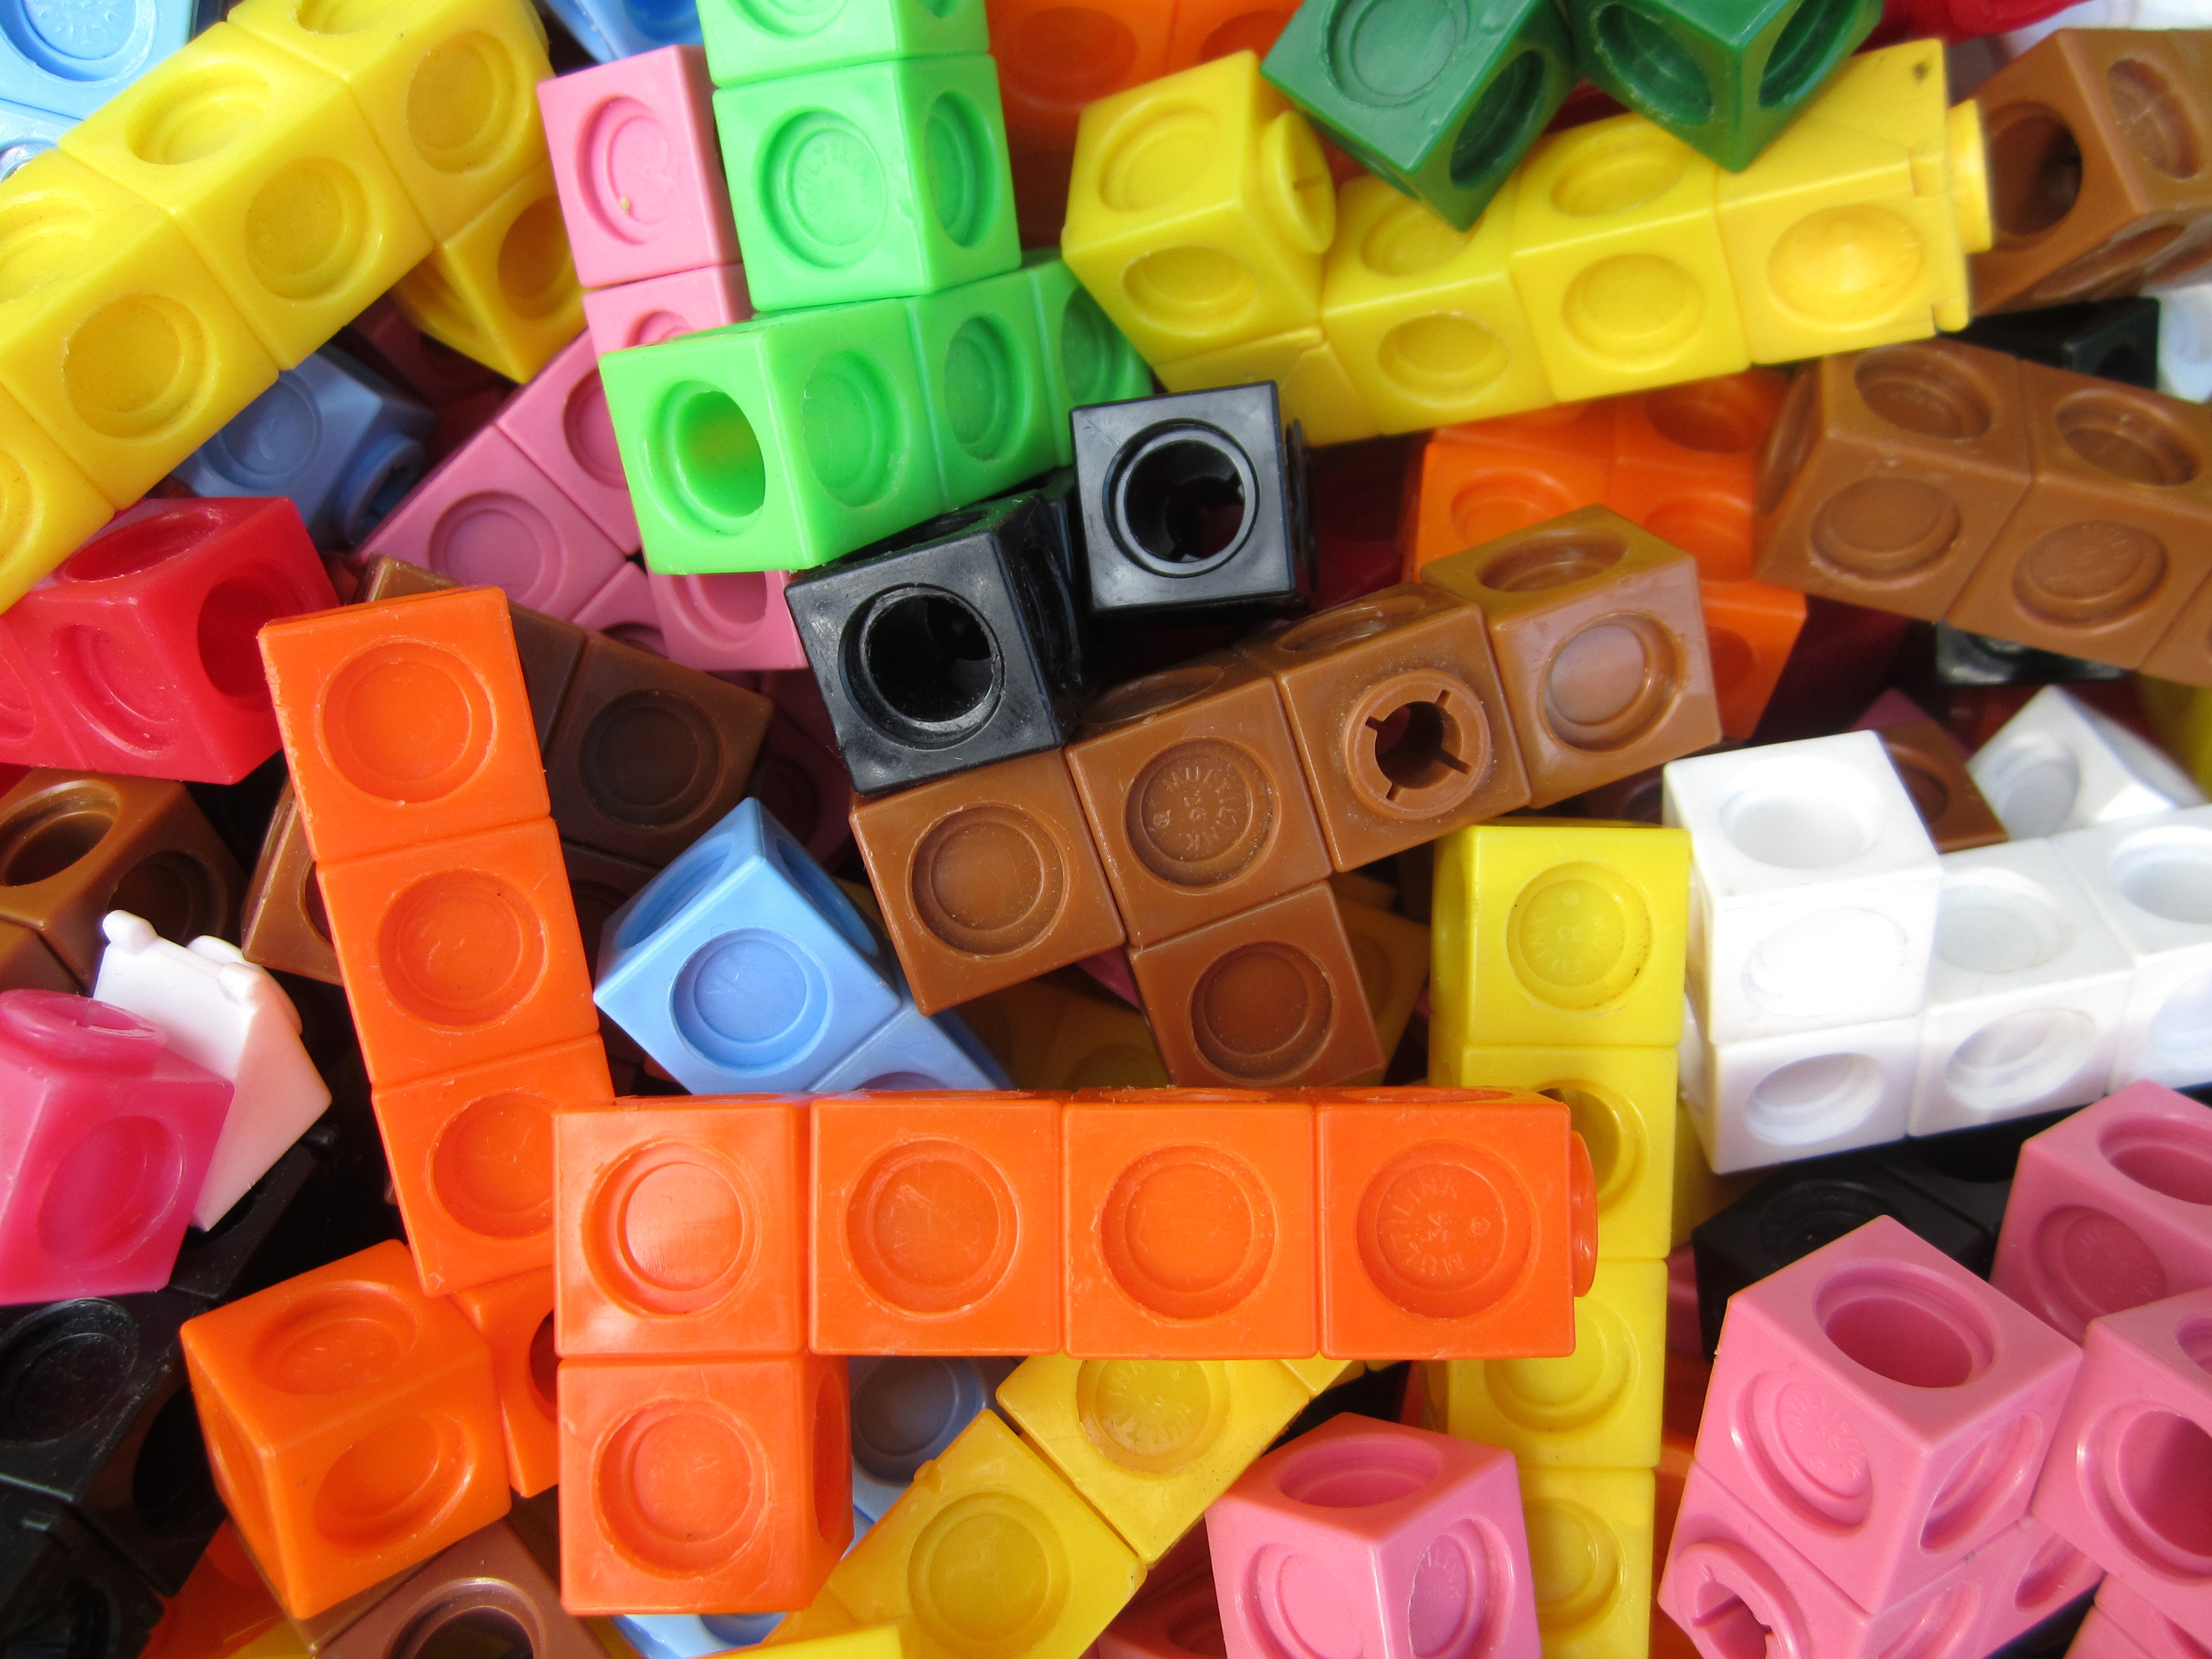
Apply – Practical Activity
Using resources (e.g. Unifix cubes, multilink etc.), create a cuboid that has a volume of 24cm³.
How many different ways can you find?

Slide 19
Apply – Problem Solving
Milly wants to design a cuboid packaging box. Using squared paper, sketch a cuboid with an estimated volume of 16cm³.

Slide 20
Apply – Reasoning
Harry says he has created a cube with an estimated volume of 20cm³.
Is this possible?
Explain how you know.

