Slide 1


.
Y5 M5g Can estimate capacity
Commissioned by The PiXL Club Ltd.
November 2019
This resource is strictly for the use of member schools for as long as they remain members of The PiXL Club. It may not be copied, sold nor transferred to a third party or used by the school after membership ceases. Until such time it may be freely used within the member school.
All opinions and contributions are those of the authors. The contents of this resource are not connected with nor endorsed by any other company, organisation or institution.
PiXL Club Ltd endeavour to trace and contact copyright owners. If there are any inadvertent omissions or errors in the acknowledgements or usage, this is unintended and PiXL will remedy these on written notification.
© Copyright The PiXL Club Limited, 2019

Slide 2
Teachers’ Notes
The PiXL therapies can be taught to a whole class or a target group. Year 3-5 therapies are designed to take approximately 30-40 minutes. However, this is flexible: it may be that only part of the therapy is taught or it could, of course, be adapted or extended.
Each therapy begins with a LORIC activity to develop relevant learning behaviours.
This is followed by a vocabulary task, which uses the PiXL 5-phase approach to teach key mathematical vocabulary. Further resources to develop vocabulary can be found in the Whole School area.
Each therapy adopts the ‘Teach, model and apply’ process with opportunities for pupils to demonstrate the taught skill independently.
Problem solving and reasoning activities are an integral part of each therapy.
This therapy lends itself to practical activities. The use of scales and practical tasks involving a range of equipment, is the best way to ensure understanding.

Slide 3
Progress across amber – the 4-stage model
The three therapy tests which accompany this resource can be used to revisit the taught skill to check that the pupil is able to perform it independently and consistently.
A
A child has successfully completed a therapy test independently, following a set of therapy sessions.
A child has successfully completed a therapy test independently, a period after the relevant therapy sessions – we would advise about 2 weeks.
A child has successfully applied their knowledge or skill in an unfamiliar context. This may be application across the curriculum or in a problem.
A pupil has successfully re-visited the skills at a later point, and applies these in an unfamiliar context or problem, or across the curriculum.
A
DA
G

Slide 4
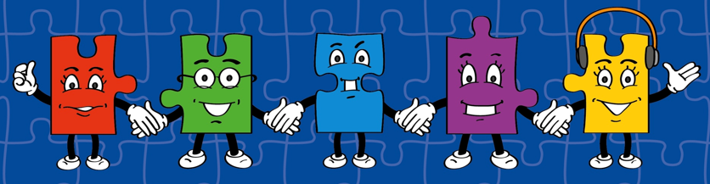
LORIC task
Our Primary Edge attributes help us to become better learners and today is no exception. Before you start this activity, here are some ideas for how you will need your Charlie Communication skills today:
Speak clearly
Discuss ideas by taking turns
Listen well

Slide 5


LORIC task
Today we are going to discuss a range of different topics.
These include:
What type of measurement would we use to measure…a can of drink, a swimming pool, a large jug etc.?
Which is bigger, a sea or an ocean? How do we know? Discuss why it would be impossible to measure the amount of water in the sea/ocean.

Slide 6
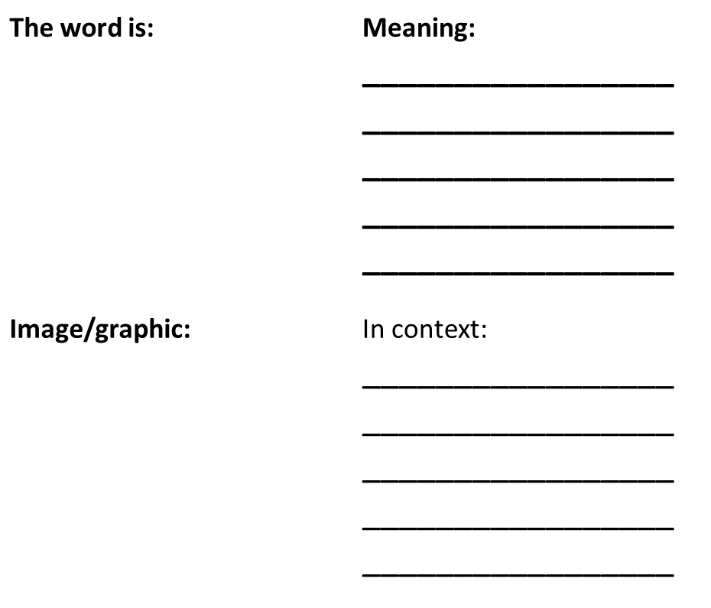
Vocabulary activity
capacity
estimate
metric
imperial
DEFINE IT/USE IT

Slide 7
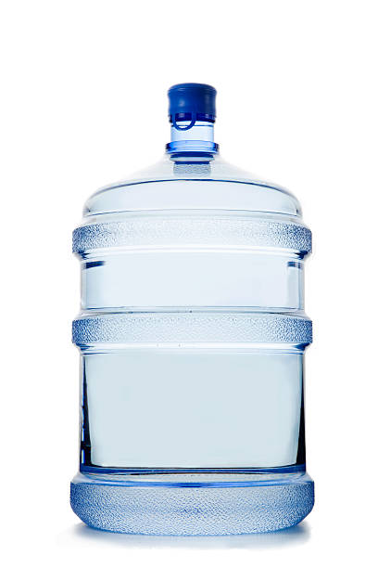
Teach
Today, we are going to estimate capacity.
Capacity means the maximum amount something can contain.

Slide 8
Teach
Capacity can be measured in millilitres and litres.
ml = millilitres
l = litres
1,000ml = 1l

Slide 9
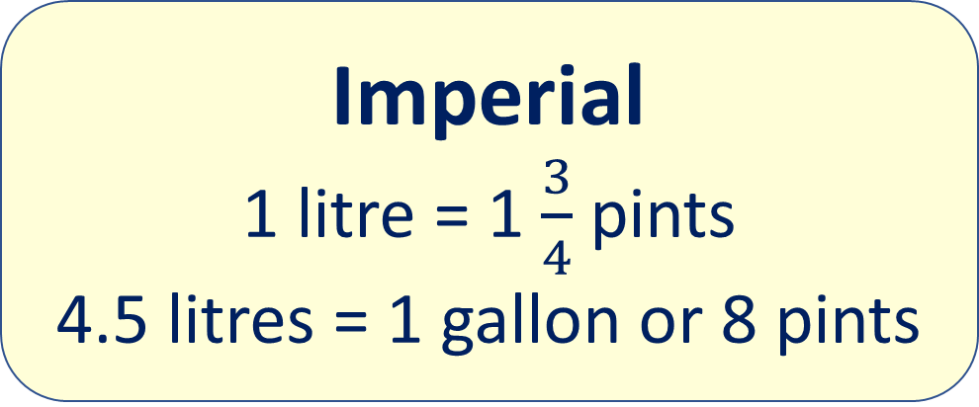
Teach
We also need to recap on our knowledge of metric and imperial measures:
Metric
1,000ml = 1l
ml = millilitres
l = litre
Imperial
1 litre = 1 $\frac{3}{4}$ pints
4.5 litres = 1 gallon or 8 pints

Slide 10
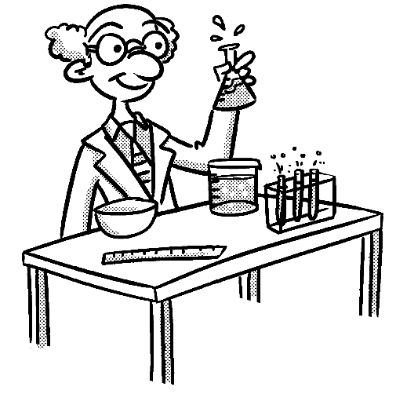
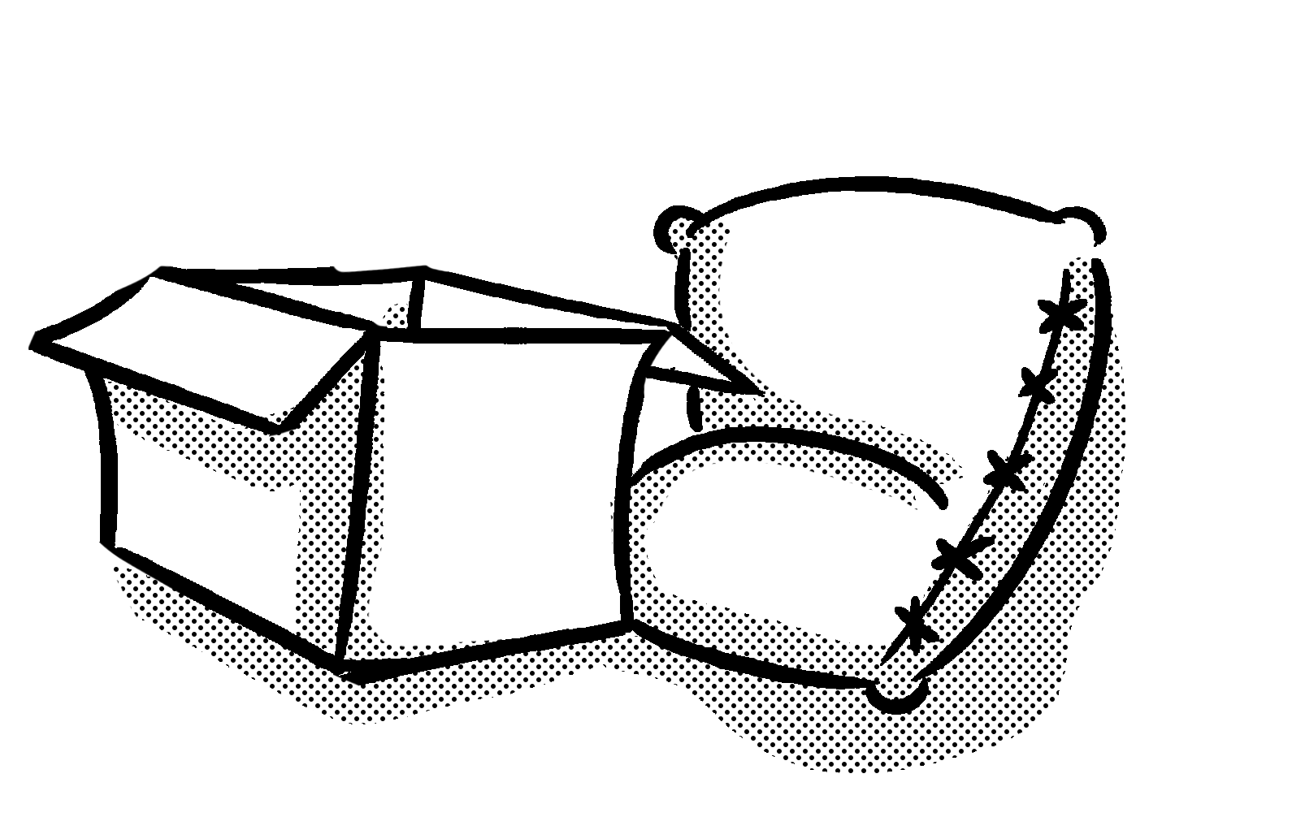
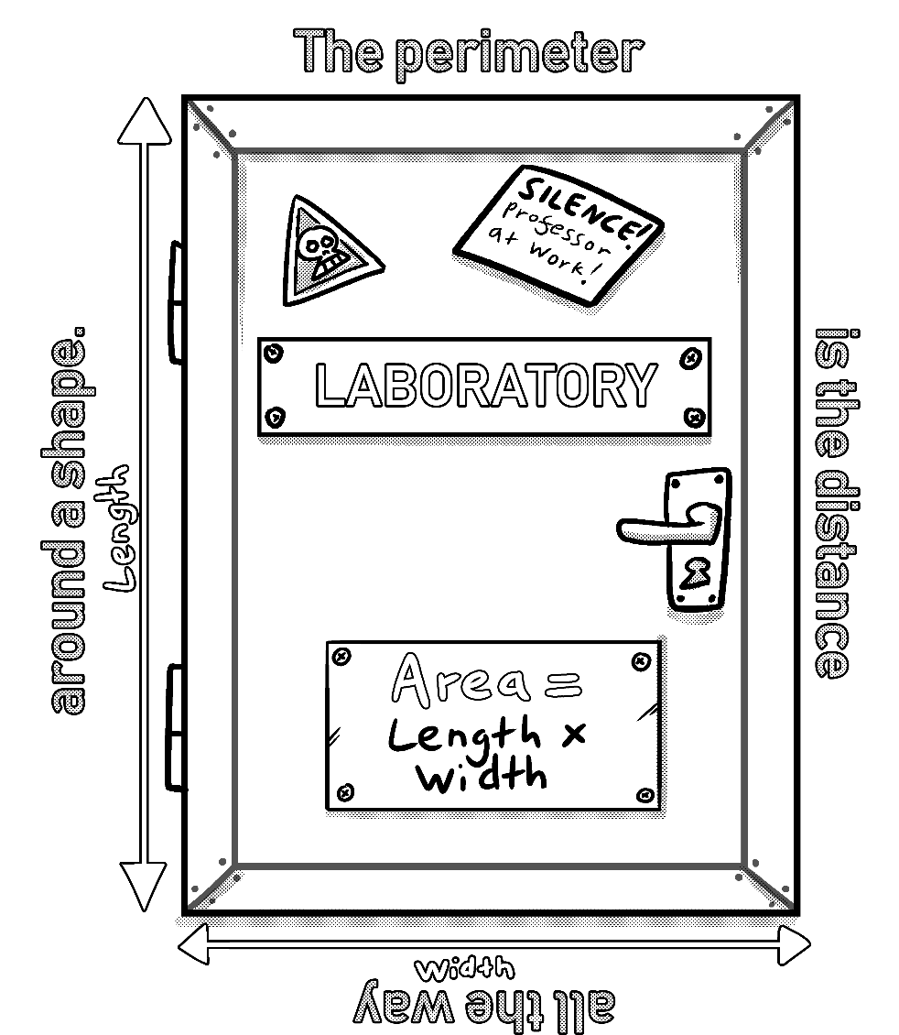
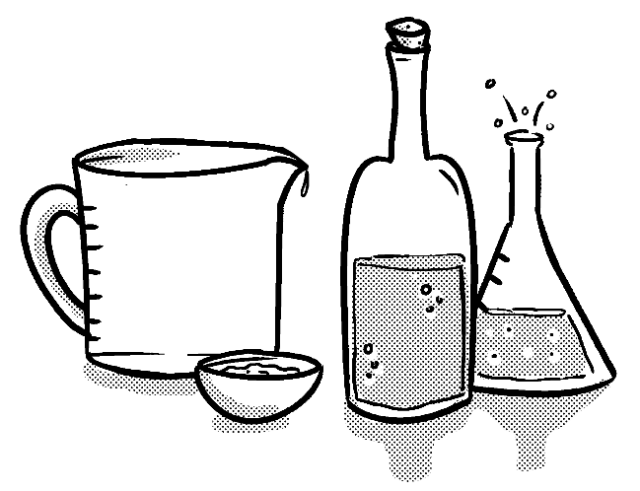
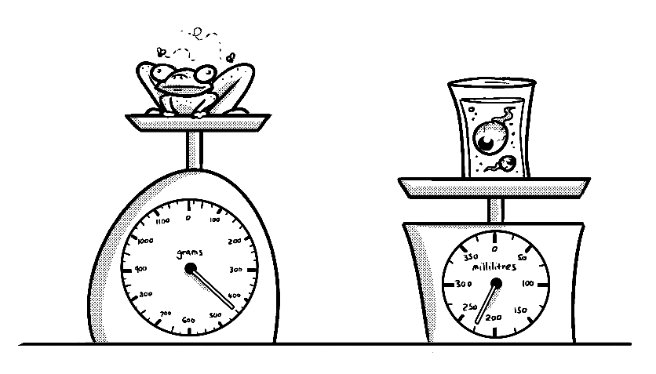
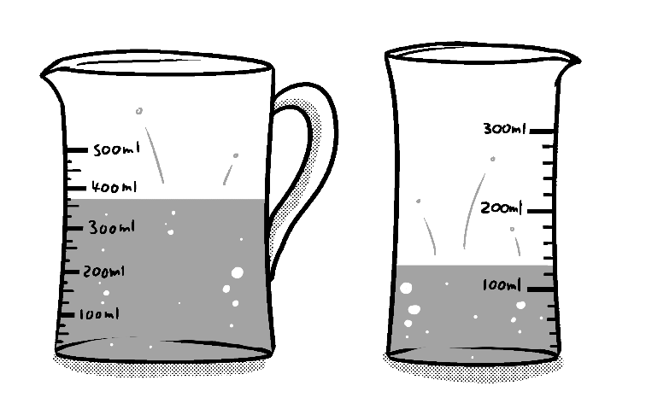
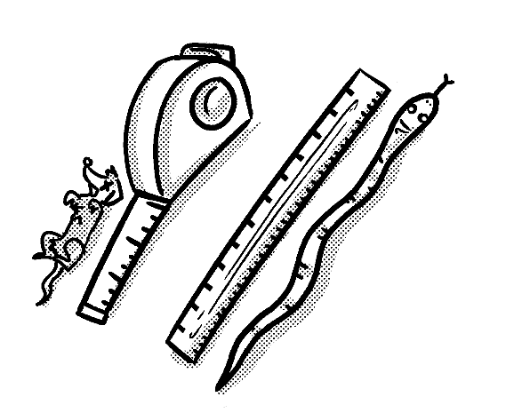
Primary Maths Measures – Years 5 and 6
Mass
1,000 grams (g) = 1 kilograms (kg)
Capacity
1,000 millilitres (ml) = 1 litre (l)
Length
10 millimetres (mm) = 1 centimetre (cm)
100 centimetres (cm) = 1 metre (m)
1,000 metres (m) = 1 kilometre (km)
© November 2018 The PiXL Club Ltd. All rights reserved.
This resource is strictly for the use of member schools for as long as they remain members of The PiXL Club Ltd.

Slide 11
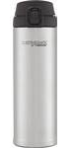
Teach
Knowing the capacity of certain objects can help when estimating unknown amounts.
If I know the larger bottle has a capacity of 650ml, I can use this knowledge to estimate the capacity of the smaller bottle.
650ml
I use annotations or markings to help me estimate that the capacity of the smaller bottle is 500ml.
500ml
325ml
0ml
Notes:
Please see the Y4 Therapy (Y4 5h) for more activities and examples like this.

Slide 12
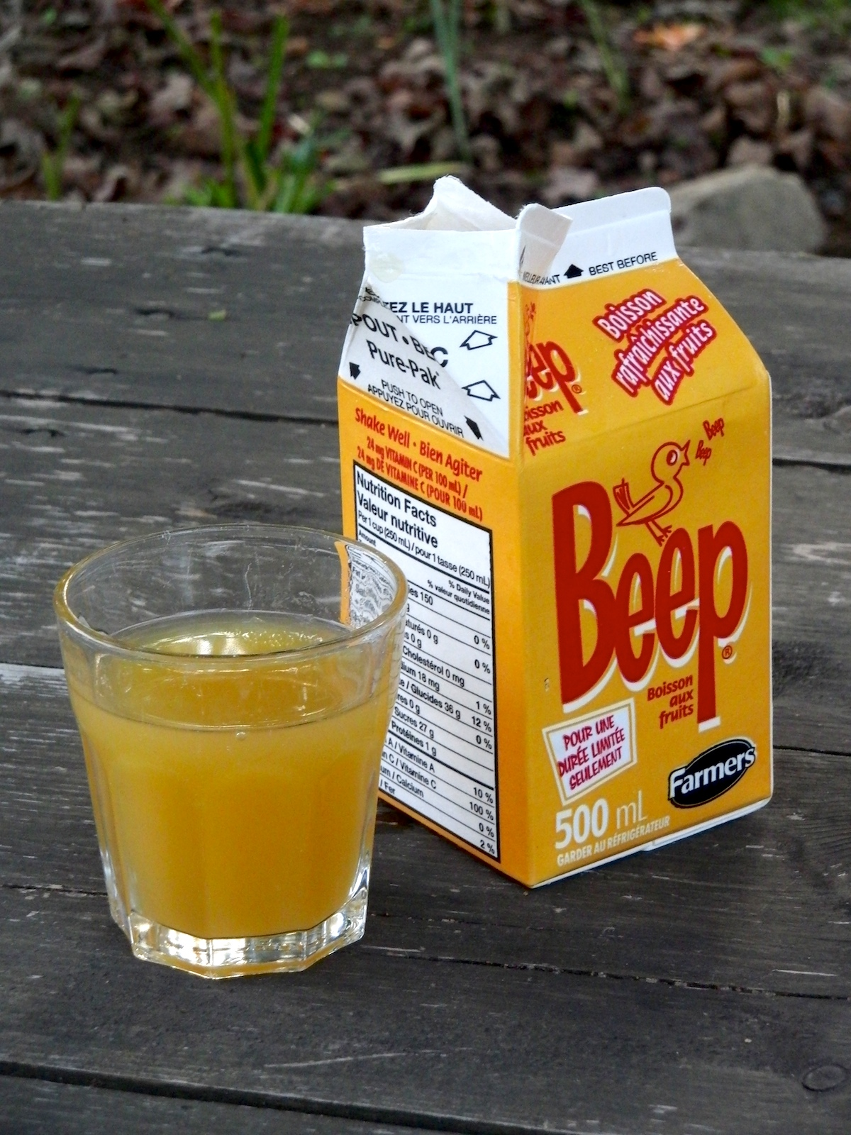
Teach
To estimate means to give a rough answer that may be a little less or a little more than the actual result/answer.
This means using knowledge of capacity to work out a rough estimation.
For example, I can estimate how many glasses of orange juice I could fill using this carton.

Slide 13
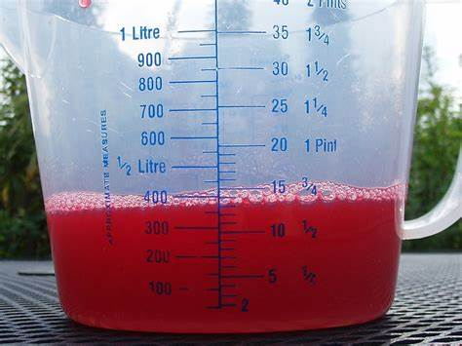

Teach
Once estimated, I can check how accurate I have been by measuring the capacity using a measuring container.
To measure accurately, I need to look at the scale.
Top tip: Make sure you read the scales at eye level so you can see the numbers and scale clearly.

Slide 14
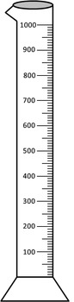
Model
To estimate means to give a rough answer that may be a little less or a little more than the actual result/ answer.
A container holds 1,000ml of liquid.
I have a cup that I think is roughly the same size as a typical drink can.
I need to estimate how many cups will be needed to fill this container.
I know that a typical drink can holds 330ml of liquid.
Therefore, I estimate that 3 cans will fill this container as
330ml x 3 = 990ml,
which is close to 1,000ml.

Slide 15
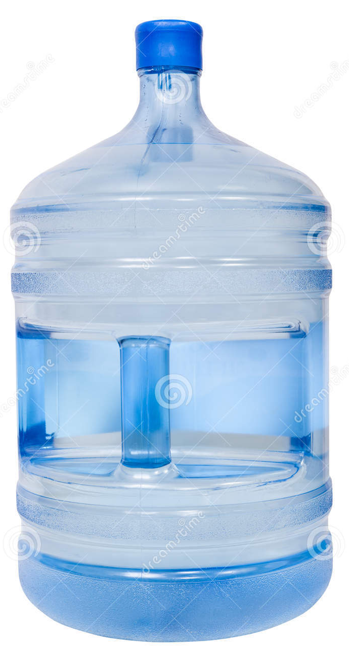
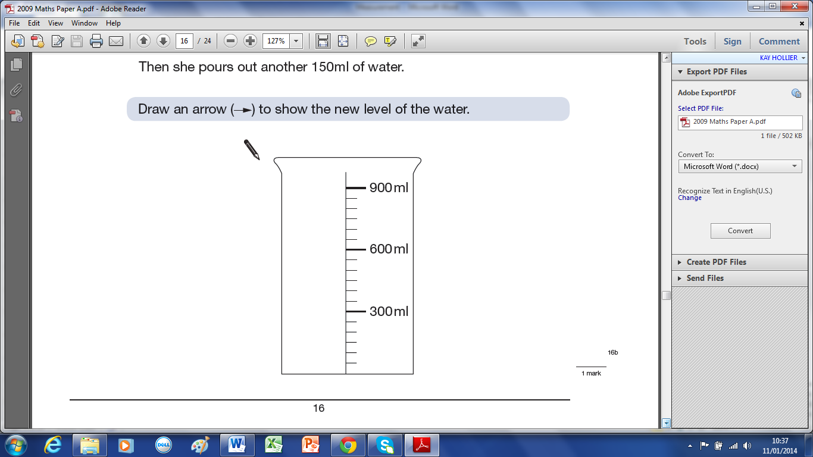
Model
Estimate how many 900ml
beakers of water would be needed to fill the large container.
The beaker I have holds just over 900ml of liquid. The water container I have is much larger.
I use my knowledge of capacity to identify that this is much larger than a 2l bottle. I think it is probably 2-3 times larger than this, so I estimate the capacity of the water container is 5l.
Not to scale

Slide 16
Model
Estimate how many 900ml beakers of water would be needed to fill the large container.
As I have estimated that the water container has a capacity of 5l, I can now estimate how many of the 900ml beakers I would need to use to fill the water container.
I know that
900ml x 5 = 4,500ml and
900ml x 6 = 5,400ml.
Therefore, I estimate that it will take about 5.5 of the beakers to fill the water container.
Not to scale

Slide 17
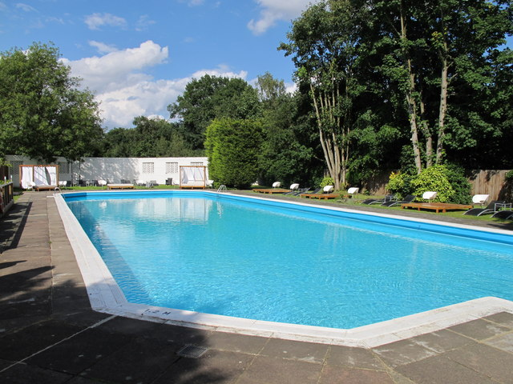
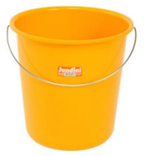
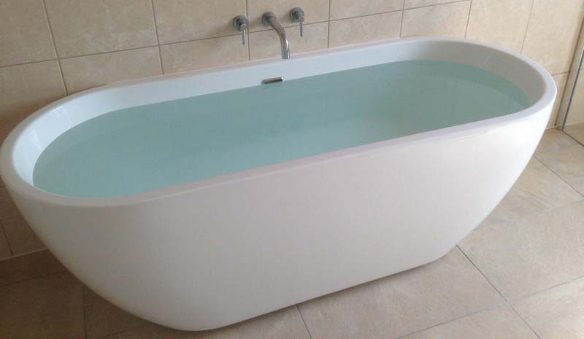
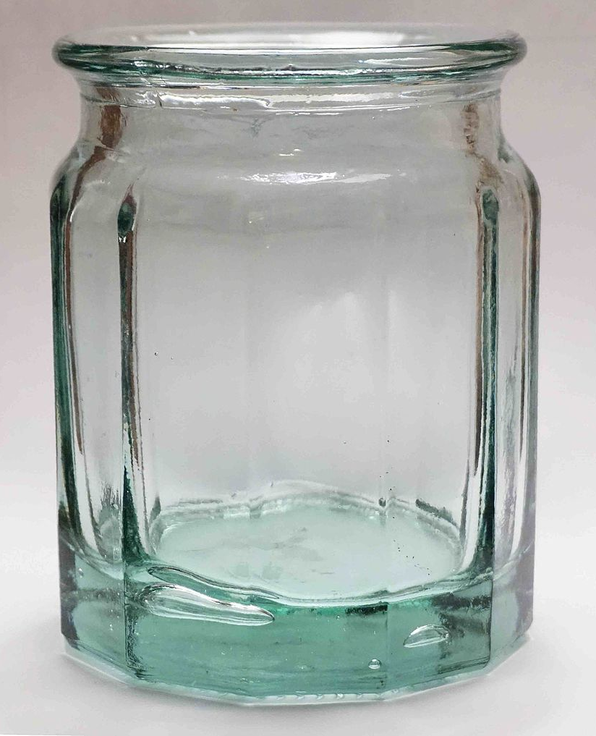
Apply
Estimate the capacity of the following. You can use your knowledge of capacity and containers to support your estimations.
Images not to scale

Slide 18
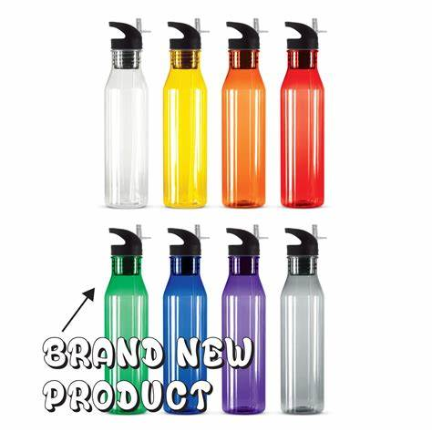
Apply
Estimate the capacity of each object. Remember to use the strategy of annotating a scale. Explain your reasoning.
A full bottle holds 1.5l of liquid.
Estimate how much liquid is in each bottle (shown by the blue line).

Slide 19

Apply – Reasoning
Sally estimates that she can fill Jug B by using 3 full jugs of liquid from Jug A.
Do you think she is correct?
Explain your reasoning.
A
B

Slide 20
Apply – Practical Activity
Measure the capacity of a cup.
Use this information to help you to estimate the capacity of
3 other containers in the classroom.
Now measure them – how accurate were you?
Challenge: Convert your measures from litres to pints (remember 1 litre = 1.75 pints).

Slide 21
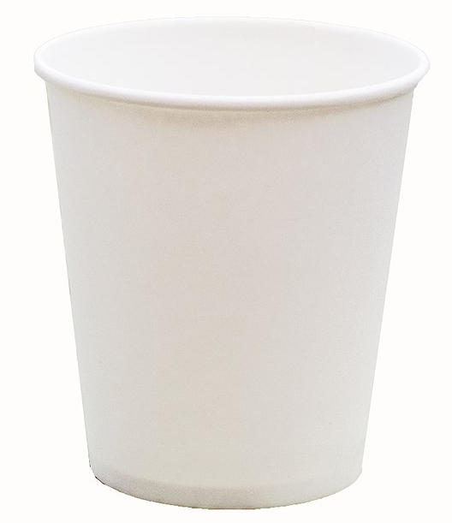

Apply – Practical Activity
Estimate how many plastic cups will be needed to fill a water jug.
Then measure the water in the cup and work out exactly how many you would need.
Challenge: Convert your answer to an imperial measure.

