Slide 1


.
Y5 M6a Can identify 3-D shapes from 2-D representations
Commissioned by The PiXL Club Ltd.
January 2020
This resource is strictly for the use of member schools for as long as they remain members of The PiXL Club. It may not be copied, sold nor transferred to a third party or used by the school after membership ceases. Until such time it may be freely used within the member school.
All opinions and contributions are those of the authors. The contents of this resource are not connected with nor endorsed by any other company, organisation or institution.
PiXL Club Ltd endeavour to trace and contact copyright owners. If there are any inadvertent omissions or errors in the acknowledgements or usage, this is unintended and PiXL will remedy these on written notification.
© Copyright The PiXL Club Limited, 2019

Slide 2
Teachers’ Notes
The PiXL therapies can be taught to a whole class or a target group. Year 3-5 therapies are designed to take approximately 30-40 minutes. However, this is flexible: it may be that only part of the therapy is taught or it could, of course, be adapted or extended.
Each therapy begins with a LORIC activity to develop relevant learning behaviours.
This is followed by a vocabulary task, which uses the PiXL 5-phase approach to teach key mathematical vocabulary. Further resources to develop vocabulary can be found in the Whole School area.
Each therapy adopts the ‘Teach, model and apply’ process with opportunities for pupils to demonstrate the taught skill independently.
Problem solving and reasoning activities are an integral part of each therapy.

Slide 3
Progress across amber – the 4-stage model
The three therapy tests which accompany this resource can be used to revisit the taught skill to check that the pupil is able to perform it independently and consistently.
A
A child has successfully completed a therapy test independently, following a set of therapy sessions.
A child has successfully completed a therapy test independently, a period after the relevant therapy sessions – we would advise about 2 weeks.
A child has successfully applied their knowledge or skill in an unfamiliar context. This may be application across the curriculum or in a problem.
A pupil has successfully re-visited the skills at a later point, and applies these in an unfamiliar context or problem, or across the curriculum.
A
DA
G

Slide 4

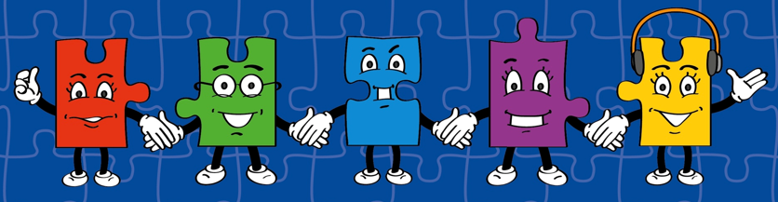
LORIC task
Our Primary Edge attributes help us to become better learners and today is no exception. Before you start this activity, here are some ideas for how you will need your Raj Resilience skills today:
Do not be put off by a difficult task.
Keep going – persevere.
Think about ways you can help yourself and others.

Slide 5

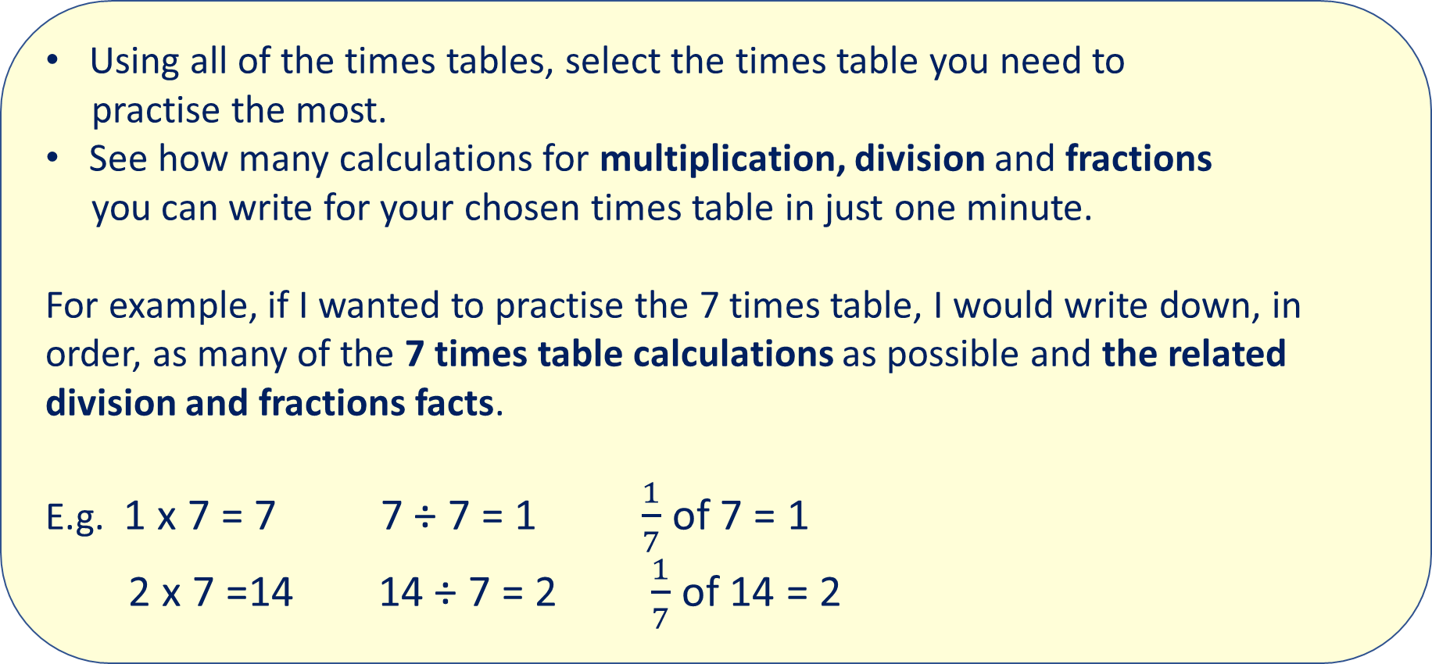
LORIC task
Using all of the times tables, select the times table you need to
practise the most.
See how many calculations for multiplication, division and fractions
you can write for your chosen times table in just one minute.
For example, if I wanted to practise the 7 times table, I would write down, in order, as many of the 7 times table calculations as possible and the related division and fractions facts.
E.g. 1 x 7 = 7 7 ÷ 7 = 1 $\frac{1}{7}$ of 7 = 1
2 x 7 =14 14 ÷ 7 = 2 $\frac{1}{7}$ of 14 = 2

Slide 6
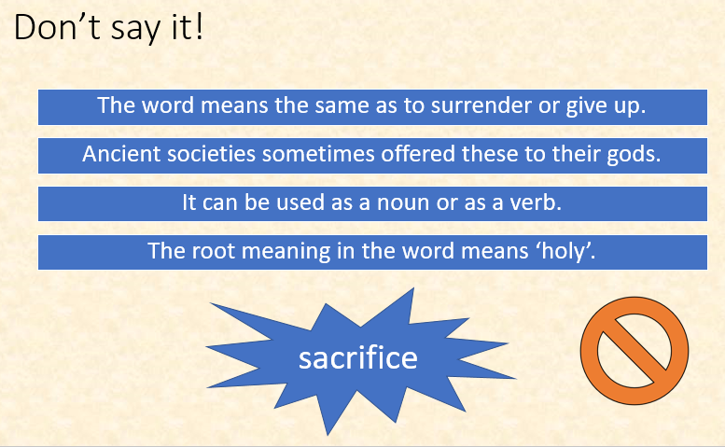
Vocabulary activity
Now try your own using a range of 2-D and 3-D shapes, e.g. describe ‘square’.
DEFINE IT
Notes:
Put pupils into groups of 4-6 pupils. Ask 1 member of each group to leave the room briefly. The remaining members of the group should select a word from the Vocabulary Mat. They will have to take it in turns to explain the meaning of this word without saying the word itself or any derivation of the word (e.g. if the word was ‘accompanied’, pupils should not use the words ‘accompany’ or ‘accompanying’.
Ask the pupils to return to the room. See how many clues they need to guess the word that has been chosen. Explicitly discuss which clue gave it away and what makes a quality clue.

Slide 7
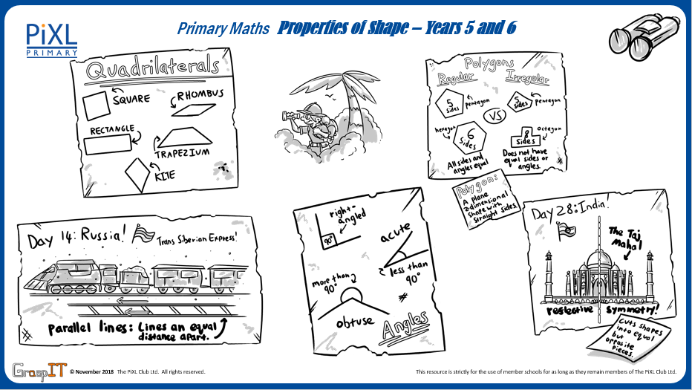
Notes:
Knowledge Mats can be helpful to support learning.

Slide 8
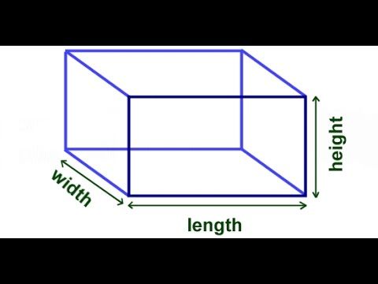
Teach
A 3-D shape is a solid shape. It has a length, width and height. This means they can be seen all the way around.
The ‘D’ stands for the word dimensional.

Slide 9
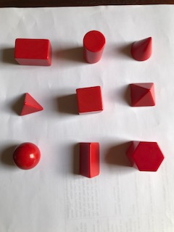
Teach
A 3-D shape is a solid shape. It has a length, width and height. This means they can be seen all the way around.
The ‘D’ stands for the word dimensional.

Slide 10
Teach
A 3-D shape is a solid shape. It has a length, width and height. This means they can be seen all the way around.
The ‘D’ stands for the word dimensional.
cuboid
cylinder
cone
triangular pyramid
cube
square-based pyramid
sphere
triangular prism
hexagonal prism

Slide 11
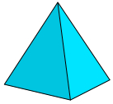
Teach
We can use the properties of a shape to describe or identify it. The properties for 3-D shapes include the number of edges, faces and vertices.
edge
face
vertex

Slide 12

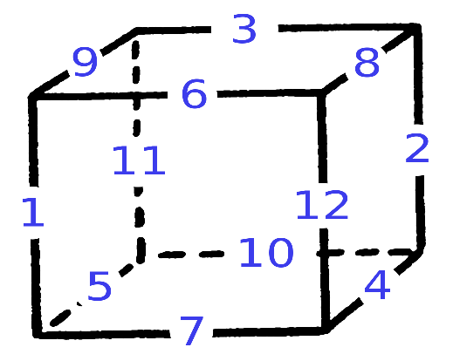
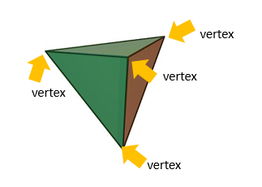
Teach
We can use the properties of a shape to describe or identify it. The properties for 3-D shapes include the number of edges, faces and vertices.
A face is the surface of a shape.
A face can be curved or flat.
An edge is the line segment where two faces of a
3-D shape meet.
A vertex (vertices when there is more than one) is the point where two edges meet.

Slide 13
Teach
A net shows what a 3-D shape would look like if opened out flat,
as a 2-D representation.
face
A net can be folded up to make a 3-D shape. You have to identify each of the faces of the shape.

Slide 14
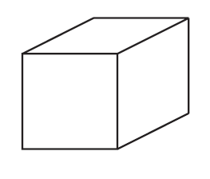
Model
A net shows what a 3-D shape would look like if opened out flat, as a 2-D representation.
A net can be folded up to make a 3-D shape.
A cube has a variety of different ways it can be represented as a net: 11 ways in total.
This is one example.

Slide 15
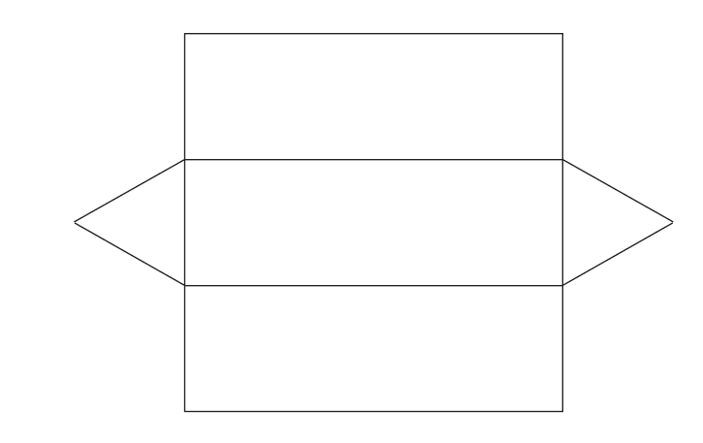
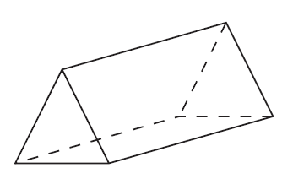
Model
A net shows what a 3-D shape would look like if opened out flat, as a 2-D representation.
A net can be folded up to make a 3-D shape.
This is an example of a net of a triangular prism.

Slide 16
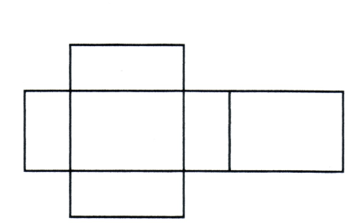
Model
A net shows what a 3-D shape would look like if opened out flat, as a 2-D representation.
A net can be folded up to make a 3-D shape.
This is an example of a net of a cuboid.

Slide 17
Apply
Which of these nets make a cube?
Tick the nets that would make a complete cube.

Slide 18
Apply – Problem Solving
Draw the shapes on the correct squares of the net of this cube.

Slide 19
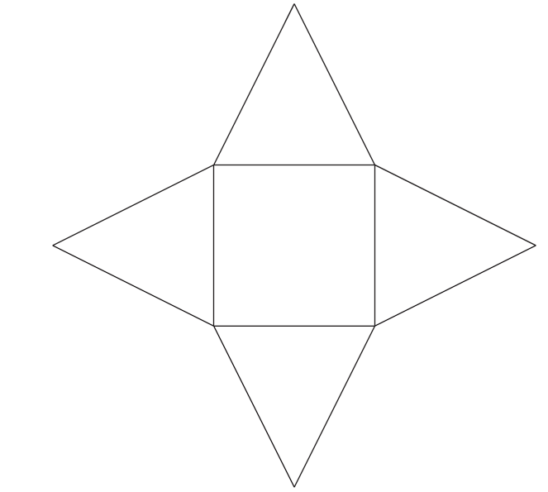
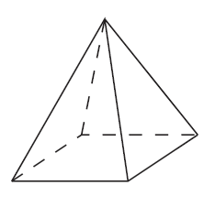
Apply – Reasoning
Sammy says that all pyramids use a square face and a triangular face like the one he has sketched here.
Is he correct?
Explain how you know.

Slide 20
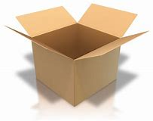
Apply – Problem Solving
Raj works for a packing company. They have designed a new box with a special lid. Design a net to create the box (like the one pictured here).
It must include the four parts to the lid.

