Slide 1


.
Y5 M6b Can estimate and compare acute, obtuse and reflex angles
Commissioned by The PiXL Club Ltd.
January 2020
This resource is strictly for the use of member schools for as long as they remain members of The PiXL Club. It may not be copied, sold nor transferred to a third party or used by the school after membership ceases. Until such time it may be freely used within the member school.
All opinions and contributions are those of the authors. The contents of this resource are not connected with nor endorsed by any other company, organisation or institution.
PiXL Club Ltd endeavour to trace and contact copyright owners. If there are any inadvertent omissions or errors in the acknowledgements or usage, this is unintended and PiXL will remedy these on written notification.
© Copyright The PiXL Club Limited, 2020

Slide 2
Teachers’ Notes
The PiXL therapies can be taught to a whole class or a target group. Year 3-5 therapies are designed to take approximately 30-40 minutes. However, this is flexible: it may be that only part of the therapy is taught or it could, of course, be adapted or extended.
Each therapy begins with a LORIC activity to develop relevant learning behaviours.
This is followed by a vocabulary task, which uses the PiXL 5-phase approach to teach key mathematical vocabulary. Further resources to develop vocabulary can be found in the Whole School area.
Each therapy adopts the ‘Teach, model and apply’ process with opportunities for pupils to demonstrate the taught skill independently.
Problem solving and reasoning activities are an integral part of each therapy.

Slide 3
Progress across amber – the 4-stage model
The three therapy tests which accompany this resource can be used to revisit the taught skill to check that the pupil is able to perform it independently and consistently.
A
A child has successfully completed a therapy test independently, following a set of therapy sessions.
A child has successfully completed a therapy test independently, a period after the relevant therapy sessions – we would advise about 2 weeks.
A child has successfully applied their knowledge or skill in an unfamiliar context. This may be application across the curriculum or in a problem.
A pupil has successfully re-visited the skills at a later point, and applies these in an unfamiliar context or problem, or across the curriculum.
A
DA
G

Slide 4

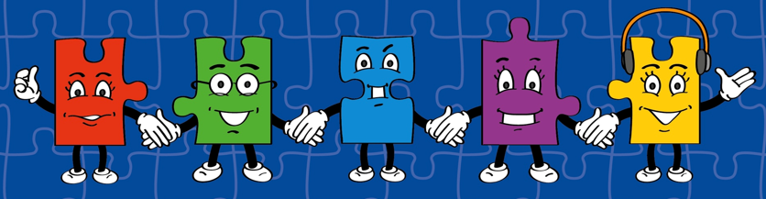
LORIC task
Our Primary Edge attributes help us to become better learners and today is no exception. Before you start this activity, here are some ideas for how you will need your Charlie Communication skills today:
Speak clearly.
Discuss ideas by taking turns.
Listen carefully.

Slide 5
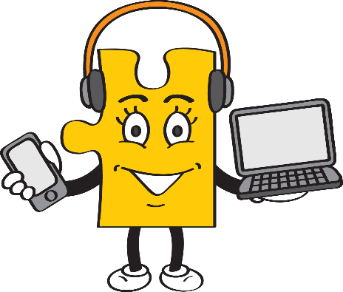
LORIC task
Look at the mathematical words provided.
Select the word that you think is the odd one out.
Explain why to a partner. Share and discuss ideas.
Which is the odd one out?
cube cuboid triangular prism
Use your Charlie Communication skills to explain your reason.

Slide 6
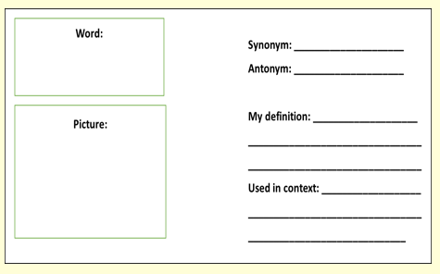
Vocabulary activity
estimate
compare
DEFINE IT / USE IT

Slide 7
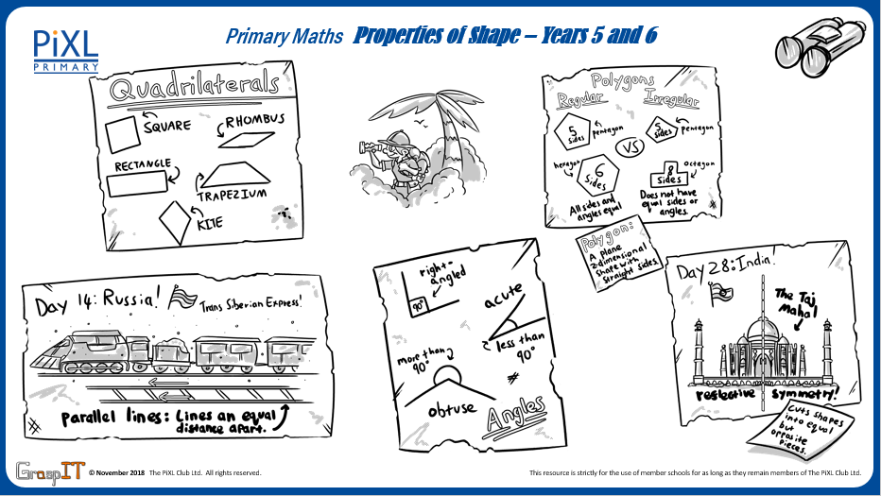
Notes:
Knowledge Mats can be helpful to support learning.

Slide 8
Teach
One way of classifying 2-D shapes is by identifying the angles in a shape.
An angle that is less than a right angle will be less than 90⁰ (degrees).
A right angle is an angle of exactly 90⁰ (degrees).
An angle that is greater than a right angle will be more than 90⁰ (degrees).

Slide 9
Teach
One way of classifying 2-D shapes is by identifying the angles in a shape.
This is called an acute angle.
This is called a right angle.
This is called an obtuse angle.

Slide 10
Teach
This is angle is called a reflex angle.
A reflex angle is an angle greater than 180⁰ and less than 360⁰.
A straight line is 180⁰ so I can use this knowledge to help me identify a reflex angle.

Slide 11
Model
A key skill is to be able to estimate an angle. Approximately, how many degrees is the marked angle?
I can use my knowledge of right angles to help me. I have drawn a right angle (in orange). This helps me to see that the marked angle is smaller than a right angle.
Therefore, this means it must be an acute angle.

Slide 12
Model
I can explore this angle further now I know it is an acute angle.
I know a right angle is 90⁰ (shown by the orange line).
I have drawn a line (in green) to show half the right angle (45⁰).
I can see that the marked angle is about half way between 45° and 90°.
I estimate the acute angle is between 65⁰ and 70⁰.

Slide 13
Apply
Estimate the following angles. Use the strategy of drawing in right angles or straight lines (180°) to be as precise as possible.

Slide 14
Model – comparing angles
Angle One
Angle Two
<
When comparing these two angles, I know that ‘Angle One’ is acute as it is less than 90⁰. I know that ‘Angle Two’ is greater than a straight line and therefore is a reflex angle.
I have used the ‘<‘ symbol to compare the two angles.

Slide 15
Model
>
Angle One
Angle Two
When comparing these two angles, I know that ‘Angle One’ is more than 180⁰ (a straight line) so it is a reflex angle.
I know that ‘Angle Two’ is an obtuse angle as it is greater than a right angle but less than 180⁰.
I have used the ‘>’ symbol to compare the two angles.

Slide 16
Model
I can also order angles. In this example, I have ordered from the smallest angle (acute angle) to the largest angle (reflex angle).

Slide 17
Apply
List these angles in ascending order.
A
B
C
D

Slide 18
Apply
Add the ‘>’ or ‘>’ symbols to compare these angles.
Angle One
Angle Two
Angle One
Angle Two

Slide 19
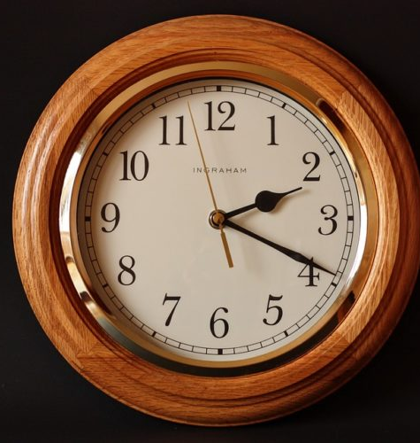


Apply – Problem Solving
Label each clock face with the correct angle.
Then list them in descending order.
A
B
C

Slide 20
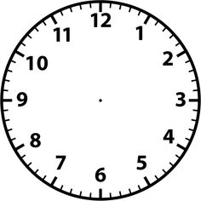
Apply – Reasoning
Danny needs to fix his clock. He knows that the hands on his clock should be at an obtuse angle.
The hour hand is at 6.
What different times could it be if the minutes hand makes
an obtuse angle with the hour hand?

