Slide 1


.
Y5 M6c Can draw angles
Commissioned by The PiXL Club Ltd.
January 2020
This resource is strictly for the use of member schools for as long as they remain members of The PiXL Club. It may not be copied, sold nor transferred to a third party or used by the school after membership ceases. Until such time it may be freely used within the member school.
All opinions and contributions are those of the authors. The contents of this resource are not connected with nor endorsed by any other company, organisation or institution.
PiXL Club Ltd endeavour to trace and contact copyright owners. If there are any inadvertent omissions or errors in the acknowledgements or usage, this is unintended and PiXL will remedy these on written notification.
© Copyright The PiXL Club Limited, 2019

Slide 2
Teachers’ Notes
The PiXL therapies can be taught to a whole class or a target group. Year 3-5 therapies are designed to take approximately 30-40 minutes. However, this is flexible: it may be that only part of the therapy is taught or it could, of course, be adapted or extended.
Each therapy begins with a LORIC activity to develop relevant learning behaviours.
This is followed by a vocabulary task, which uses the PiXL 5-phase approach to teach key mathematical vocabulary. Further resources to develop vocabulary can be found in the Whole School area.
Each therapy adopts the ‘Teach, model and apply’ process with opportunities for pupils to demonstrate the taught skill independently.
Problem solving and reasoning activities are an integral part of each therapy.

Slide 3
Progress across amber – the 4-stage model
The three therapy tests which accompany this resource can be used to revisit the taught skill to check that the pupil is able to perform it independently and consistently.
A
A child has successfully completed a therapy test independently, following a set of therapy sessions.
A child has successfully completed a therapy test independently, a period after the relevant therapy sessions – we would advise about 2 weeks.
A child has successfully applied their knowledge or skill in an unfamiliar context. This may be application across the curriculum or in a problem.
A pupil has successfully re-visited the skills at a later point, and applies these in an unfamiliar context or problem, or across the curriculum.
A
DA
G

Slide 4

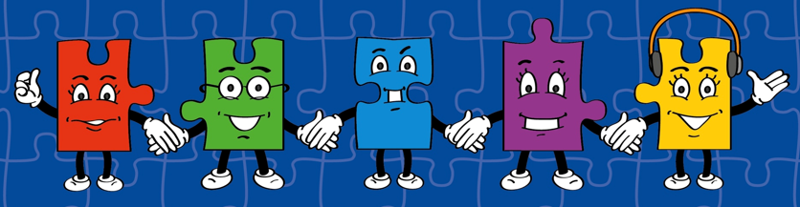
LORIC task
Our Primary Edge attributes help us to become better learners and today is no exception. Before you start this activity, here are some ideas for how you will need your Raj Resilience skills today:
Do not be put off by a difficult task.
Keep going – persevere.
Think about ways you can help yourself and others.

Slide 5

LORIC task
How many different possibilities can you find?
x
x
=
60

Slide 6
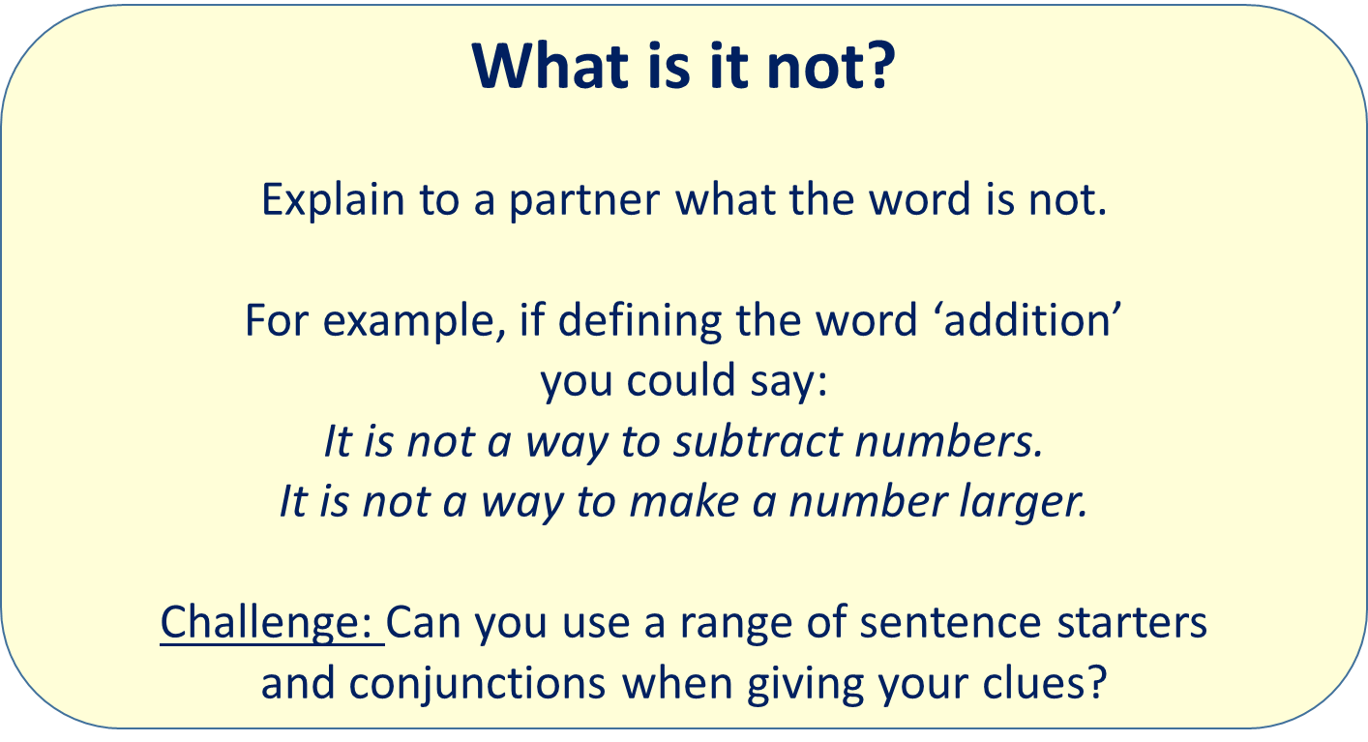
Vocabulary activity
acute angle
right angle
obtuse angle
reflex angle
DEFINE IT
Notes:
In order to fully embed new language, pupils should be able to discuss word meaning at a deep level, including what a word does not mean as well as defining it. Give half of the pupils in the class a word. Ask them to explain to their partner what the word is not. Who can guess the word first? Ask pupils to explain how they knew. Take it in turns and discuss what makes a good clue. Support pupils in using different oral sentence starters and a range of conjunctions to discuss their ideas.

Slide 7
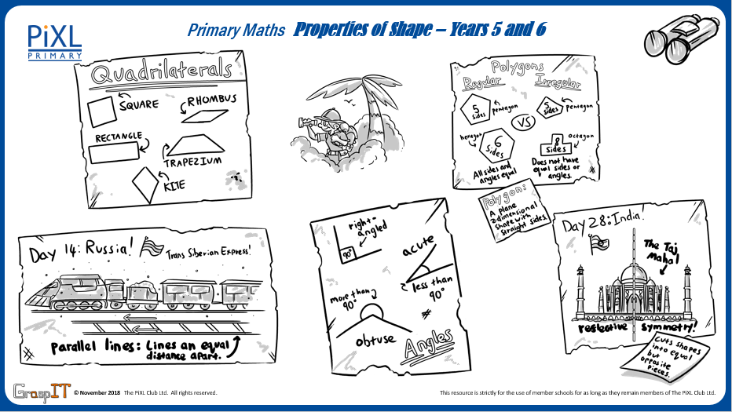
Notes:
Knowledge Mats can be helpful to support learning.

Slide 8
Teach
These are the different types of angles:
An angle that is less than a right angle will be less than 90⁰ (degrees).
A right angle is an angle of exactly 90⁰ (degrees).
An angle that is greater than a right angle will be more than 90⁰ (degrees).
A reflex angle is one greater than 180⁰ and less than 360⁰.

Slide 9
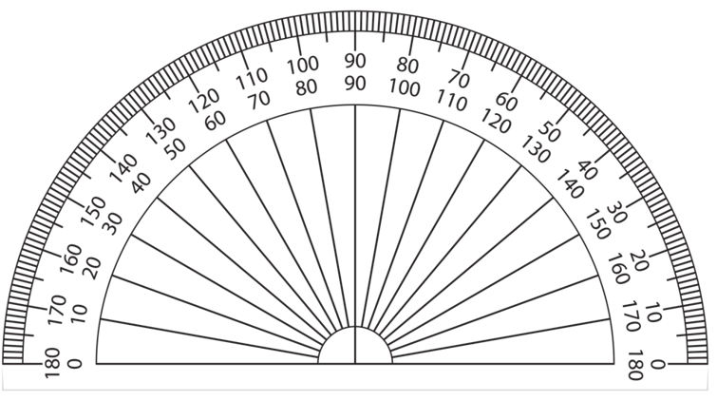
Teach
To draw an angle, a special piece of equipment is needed.
It is called a protractor or angle measurer.

Slide 10
Teach
The protractor is divided into 180 degrees which are labelled in intervals of 10⁰.

Slide 11
Teach
It is important that you always start at 0⁰. The size of your angle and starting position will determine whether you start at the left or right hand side of the protractor.
This shows
60⁰ in two
different ways.

Slide 12
Model
To draw an angle, the first thing you need to do is draw one straight line.

Slide 13
Model
Then, place a mark at the end that you will draw the angle from.

Slide 14
Model
After this, you need to place the centre of the protractor on the mark. It must also line up with the line you have drawn.

Slide 15
Model
You then need to find the required angle on the scale (for example, 50⁰) and place a mark above the measure on the protractor.
TOP TIP: Make sure you start at 0⁰ (on your line) and follow the numbers in ascending order. In this case, we are following the scale on the outside of the protractor.

Slide 16
Model
At this point, you can remove the protractor
Then you need to draw a line (with a ruler) to join the two marks.
50⁰

Slide 17
Model
This angle measures 50⁰ which means it is an acute angle.

Slide 18
Model
I can check my accuracy by placing the protractor over my drawn angle.
This angle measures 50⁰ which means it is an acute angle.

Slide 19
Apply
Using a protractor, draw the following angles:
80⁰
120°
15°
112°°

Slide 20
Apply – Problem Solving
Which is the correctly drawn angle for 40⁰?
Explain how you know.
A
B

Slide 21
Apply – Reasoning
Scott thinks he has drawn an obtuse angle of 150⁰.
He is incorrect.
Draw an angle of 150⁰ and explain the error Scott made.

