Slide 1


.
Y5 M6d Can identify angles at a point and one whole turn (360⁰)
Commissioned by The PiXL Club Ltd.
January 2020
This resource is strictly for the use of member schools for as long as they remain members of The PiXL Club. It may not be copied, sold nor transferred to a third party or used by the school after membership ceases. Until such time it may be freely used within the member school.
All opinions and contributions are those of the authors. The contents of this resource are not connected with nor endorsed by any other company, organisation or institution.
PiXL Club Ltd endeavour to trace and contact copyright owners. If there are any inadvertent omissions or errors in the acknowledgements or usage, this is unintended and PiXL will remedy these on written notification.
© Copyright The PiXL Club Limited, 2019

Slide 2
Teachers’ Notes
The PiXL therapies can be taught to a whole class or a target group. Year 3-5 therapies are designed to take approximately 30-40 minutes. However, this is flexible: it may be that only part of the therapy is taught or it could, of course, be adapted or extended.
Each therapy begins with a LORIC activity to develop relevant learning behaviours.
This is followed by a vocabulary task, which uses the PiXL 5-phase approach to teach key mathematical vocabulary. Further resources to develop vocabulary can be found in the Whole School area.
Each therapy adopts the ‘Teach, model and apply’ process with opportunities for pupils to demonstrate the taught skill independently.
Problem solving and reasoning activities are an integral part of each therapy.

Slide 3
Progress across amber – the 4-stage model
The three therapy tests which accompany this resource can be used to revisit the taught skill to check that the pupil is able to perform it independently and consistently.
A
A child has successfully completed a therapy test independently, following a set of therapy sessions.
A child has successfully completed a therapy test independently, a period after the relevant therapy sessions – we would advise about 2 weeks.
A child has successfully applied their knowledge or skill in an unfamiliar context. This may be application across the curriculum or in a problem.
A pupil has successfully re-visited the skills at a later point, and applies these in an unfamiliar context or problem, or across the curriculum.
A
DA
G

Slide 4

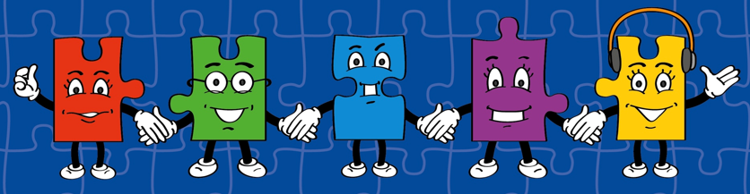
LORIC task
Our Primary Edge attributes help us to become better learners and today is no exception. Before you start this activity, here are some ideas for how you will need your Raj Resilience skills today:
Do not be put off by a difficult task.
Keep going – persevere.
Think about ways you can help yourself and others.

Slide 5

LORIC task
Use the numbers 3, 6, 8 and 5.
Make the total closest to 3,000.
x
=

Slide 6
Vocabulary activity
identify
whole
point
ALL PHASES
The word is…
Act it out
Give a definition or use it in a sentence
Suggest a synonym and an antonym
Draw a picture of it
Describe it without saying the word itself
Give examples of similar spellings/ rhyming words
Notes:
This game requires pupils to manipulate and demonstrate their understanding of the same word in lots of different ways. Print copies of the wheel (laminated, these can be reused multiple times). Give pupils a wheel between 2 or 3 and ask them to select a word from a given list (see Vocabulary Mats or Statutory words lists). Pupils should then spin the wheel and represent the new vocabulary using the method the wheel lands on.

Slide 7
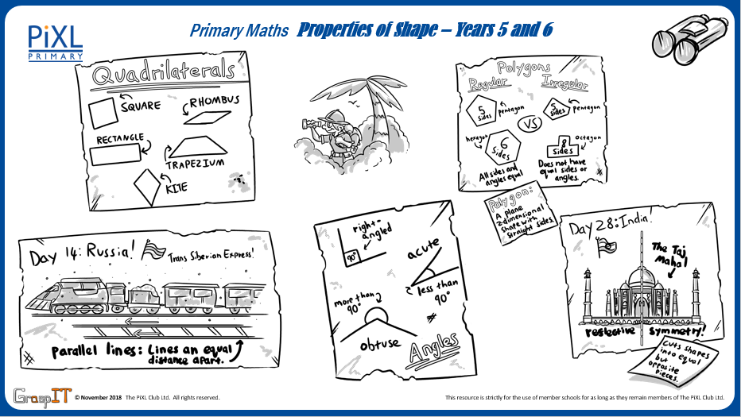
Notes:
Knowledge Mats can be helpful to support learning.

Slide 8
Teach
One whole turn is the same as 360⁰.

Slide 9
Teach
When identifying an angle at a point and one whole turn, I need to use my knowledge of a whole turn being 360⁰.
90⁰
?⁰

Slide 10
Teach
To work out the missing angle, I need to subtract
90⁰ from 360⁰:
90⁰
?⁰
360 - 90 = 270°

Slide 11
Model
I know that one angle is 125⁰. I can subtract this from 360⁰ to identify the missing angle.
125⁰
Which mental calculation strategy could you use?
?⁰
360 – 125 = 235°

Slide 12
Model
The missing angle is 235⁰.
I can also check this using the inverse operation to add the two angles together.
125⁰
235⁰
235 + 125 = 360°

Slide 13
Apply
Identify the missing angle.
?⁰
280⁰

Slide 14
Model
70⁰
90⁰
I know with this problem I have to identify the missing angle at the point.
50⁰
?⁰

Slide 15
Model
To work out the missing angle, I need to total the given angles then subtract this from 360⁰.
70⁰
90⁰
Which mental calculation strategies could you use?
?⁰
50⁰
70 + 90 + 50 = 210
360 – 210 = 150

Slide 16
Model
This means the missing angle is 150⁰.
70⁰
90⁰
I can check my answer by adding all of the angles.
They add up to 360⁰ in total, so I know I am correct.
50⁰
150⁰

Slide 17
Apply
Identify the missing angle at the point.
60⁰
90⁰
?⁰
105⁰

Slide 18
Apply
Identify the missing angle at the point.
?⁰
225⁰

Slide 19

Apply – Problem Solving
Jamal is looking at a compass. What are the angles for the following (all going in a clockwise direction)?
North to South
East to North
West to North
East to East
North to South West

Slide 20
Apply – Reasoning
Jo says that the missing angles at both points are the same. Is she correct? Explain how you know.
55⁰
90⁰
?⁰
A
230⁰
?⁰
105⁰
B

