Slide 1


.
Y5 M6e Can identify angles at a point on a straight line and half turn (180⁰)
Commissioned by The PiXL Club Ltd.
January 2020
This resource is strictly for the use of member schools for as long as they remain members of The PiXL Club. It may not be copied, sold nor transferred to a third party or used by the school after membership ceases. Until such time it may be freely used within the member school.
All opinions and contributions are those of the authors. The contents of this resource are not connected with nor endorsed by any other company, organisation or institution.
PiXL Club Ltd endeavour to trace and contact copyright owners. If there are any inadvertent omissions or errors in the acknowledgements or usage, this is unintended and PiXL will remedy these on written notification.
© Copyright The PiXL Club Limited, 2019

Slide 2
Teachers’ Notes
The PiXL therapies can be taught to a whole class or a target group. Year 3-5 therapies are designed to take approximately 30-40 minutes. However, this is flexible: it may be that only part of the therapy is taught or it could, of course, be adapted or extended.
Each therapy begins with a LORIC activity to develop relevant learning behaviours.
This is followed by a vocabulary task, which uses the PiXL 5-phase approach to teach key mathematical vocabulary. Further resources to develop vocabulary can be found in the Whole School area.
Each therapy adopts the ‘Teach, model and apply’ process with opportunities for pupils to demonstrate the taught skill independently.
Problem solving and reasoning activities are an integral part of each therapy.

Slide 3
Progress across amber – the 4-stage model
The three therapy tests which accompany this resource can be used to revisit the taught skill to check that the pupil is able to perform it independently and consistently.
A
A child has successfully completed a therapy test independently, following a set of therapy sessions.
A child has successfully completed a therapy test independently, a period after the relevant therapy sessions – we would advise about 2 weeks.
A child has successfully applied their knowledge or skill in an unfamiliar context. This may be application across the curriculum or in a problem.
A pupil has successfully re-visited the skills at a later point, and applies these in an unfamiliar context or problem, or across the curriculum.
A
DA
G

Slide 4

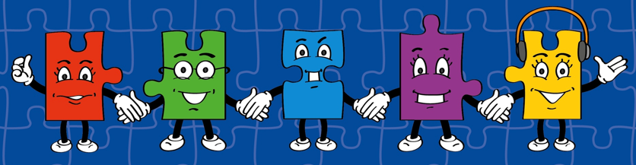
LORIC task
Our Primary Edge attributes help us to become better learners and today is no exception. Before you start this activity, here are some ideas for how you will need your Charlie Communication skills today:
Speak clearly.
Discuss ideas by taking turns.
Listen carefully.

Slide 5

LORIC task
Which is the odd one out?
45⁰ 90⁰ 180⁰ 270⁰
Use your Charlie Communication skills to explain your reason.

Slide 6
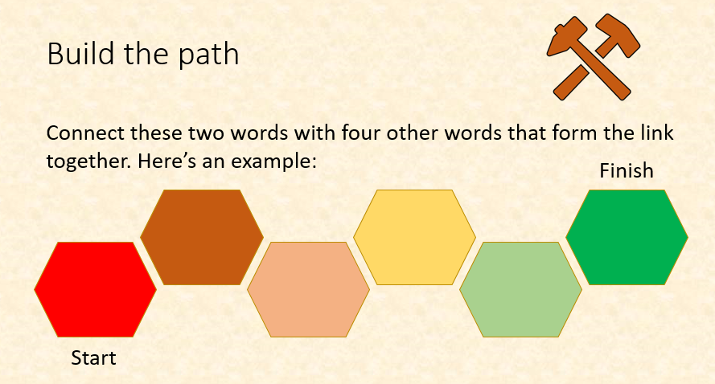
Vocabulary activity
point
straight line
LINK IT
Notes:
In this activity, pupils will be asked to reason about vocabulary. Teachers may wish to award points or rewards for ambitious choices or excellent explanations. Pupils should be encouraged to think creatively about how to ‘build the path’ between the two words. Perhaps this could be through spelling patterns, word meaning or association, words with the same roots or another pattern that they outline themselves.

Slide 7
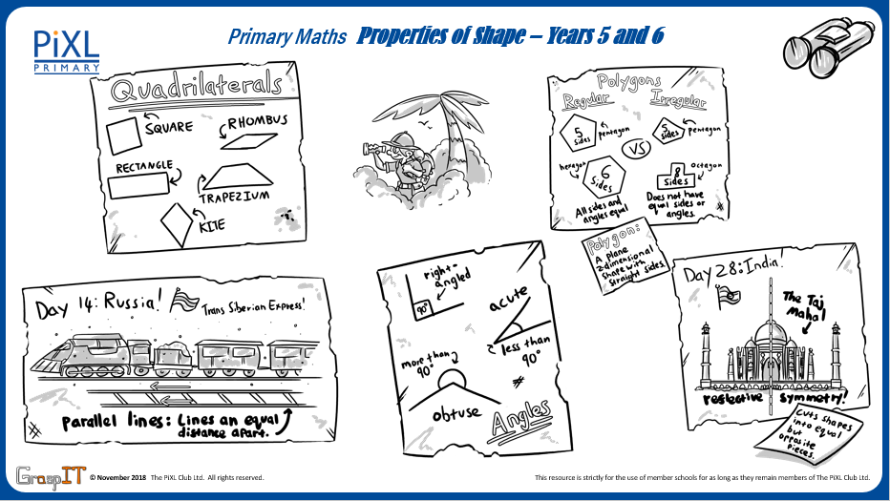
Notes:
Knowledge Mats can be helpful to support learning.

Slide 8
Teach
One whole turn is the same as 360⁰.
360⁰

Slide 9
Teach
One half turn is the same as 180⁰.
We can use this information to solve missing angle problems.
180⁰

Slide 10
Teach
Calculate the missing angle.
180⁰
?⁰
45⁰

Slide 11
Teach
To work out the missing angle, I need to subtract 45⁰ from 180⁰:
180 – 45 = 135°
?⁰
45⁰

Slide 12
Teach
This means I know the missing angle is 135⁰. I can check my working out by using the inverse operation to add the two angles together to check they total 180⁰.
45⁰
?⁰
135 + 45 = 180°

Slide 13
Model
I know that one angle is 110⁰ so I can subtract this from 180⁰ to identify the angle on the line.
180 – 110 = 90°
110⁰
?⁰

Slide 14
Model
The missing angle is 70⁰. I can also check this by using the inverse operation to add the two angles together and check they total 180⁰.
70 + 110 = 180°
110⁰
?⁰

Slide 15
Apply
Identify the missing angle.
?⁰
65⁰

Slide 16
Apply
Identify the missing angle.
?⁰
72⁰

Slide 17
Model
I know with this problem I have to identify the missing angle.
90⁰
55⁰
I know if I add 90⁰ + 55⁰ the answer is 145⁰.
?⁰

Slide 18
Model
To work out the missing number, I now need to subtract 145⁰ from 180⁰.
90⁰
55⁰
180 – 145 = 35°
?⁰

Slide 19
Model
This means the missing angle is 35⁰.
90⁰
I can check my answer by adding all of the angles together. They add up to 180⁰ in total, so I know I am correct.
55⁰
?⁰

Slide 20
Apply
73⁰
Identify the missing angle.
48⁰
?⁰

Slide 21
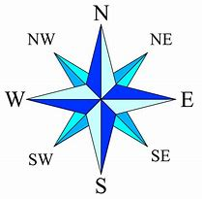
Apply – Problem Solving
Bernie is using a compass. He makes a number of statements. Complete the following table to show which ones are correct and which ones are not:
 | True | False
A straight line is 180⁰.
North-East to North-West is the same as 180⁰.
North-East to South-West is the same as 180⁰.

Slide 22
Apply – Reasoning
Eric says that the missing angles on both points are the same. Is he correct? Explain how you know.
26⁰
55⁰
A
?⁰
?⁰
67⁰
38⁰
B

