Slide 1


.
Y5 M6f Can use properties of rectangles, including diagonals, to deduce related facts and find missing lengths and angles
Commissioned by The PiXL Club Ltd.
January 2020
This resource is strictly for the use of member schools for as long as they remain members of The PiXL Club. It may not be copied, sold nor transferred to a third party or used by the school after membership ceases. Until such time it may be freely used within the member school.
All opinions and contributions are those of the authors. The contents of this resource are not connected with nor endorsed by any other company, organisation or institution.
PiXL Club Ltd endeavour to trace and contact copyright owners. If there are any inadvertent omissions or errors in the acknowledgements or usage, this is unintended and PiXL will remedy these on written notification.
© Copyright The PiXL Club Limited, 2019

Slide 2
Teachers’ Notes
The PiXL therapies can be taught to a whole class or a target group. Year 3-5 therapies are designed to take approximately 30-40 minutes. However, this is flexible: it may be that only part of the therapy is taught or it could, of course, be adapted or extended.
Each therapy begins with a LORIC activity to develop relevant learning behaviours.
This is followed by a vocabulary task, which uses the PiXL 5-phase approach to teach key mathematical vocabulary. Further resources to develop vocabulary can be found in the Whole School area.
Each therapy adopts the ‘Teach, model and apply’ process with opportunities for pupils to demonstrate the taught skill independently.
Problem solving and reasoning activities are an integral part of each therapy.

Slide 3
Progress across amber – the 4-stage model
The three therapy tests which accompany this resource can be used to revisit the taught skill to check that the pupil is able to perform it independently and consistently.
A
A child has successfully completed a therapy test independently, following a set of therapy sessions.
A child has successfully completed a therapy test independently, a period after the relevant therapy sessions – we would advise about 2 weeks.
A child has successfully applied their knowledge or skill in an unfamiliar context. This may be application across the curriculum or in a problem.
A pupil has successfully re-visited the skills at a later point, and applies these in an unfamiliar context or problem, or across the curriculum.
A
DA
G

Slide 4

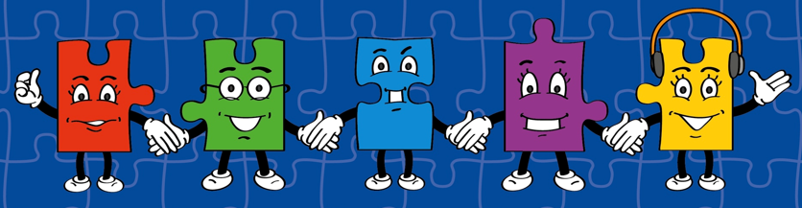
LORIC task
Our Primary Edge attributes help us to become better learners and today is no exception. Before you start this activity, here are some ideas for how you will need your Charlie Communication skills today:
Speak clearly.
Discuss ideas by taking turns.
Listen carefully.

Slide 5

LORIC task
Look at the maths vocabulary provided.
Select the word that you think is the odd one out.
Explain why to a partner. Share and discuss ideas.
Which is the odd one out?
pentagon rectangle square Use your Charlie Communication skills to explain your reason.

Slide 6
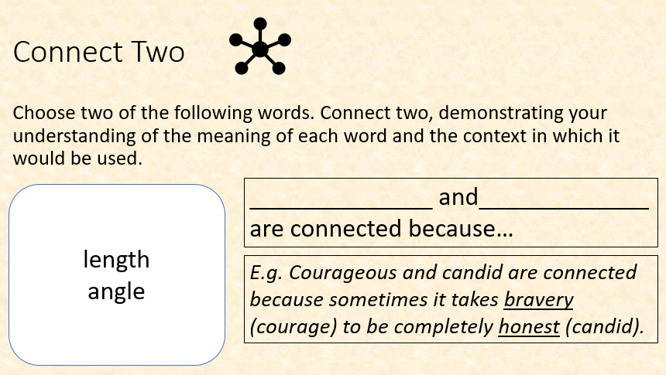
Vocabulary activity
point
straight line
LINK IT
Notes:
Give pupils a list of relevant and challenging vocabulary. Ask them to make connections between two words on the list and explain this using the sentence frame provided.
To challenge pupils further, ask them to change one word and then reconnect this to their original word. How much do they have to change the connection that they made? Can they connect three?
Encourage pupils to use ambitious conjunctions to explain the connections such as: although, however, further, despite

Slide 7
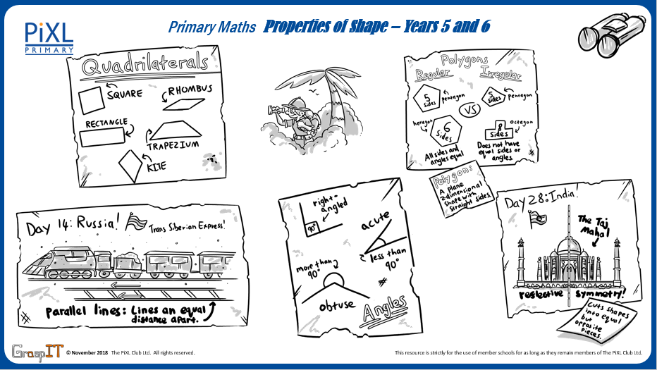
Notes:
Knowledge Mats can be helpful to support learning.

Slide 8
Teach
To be able to find missing lengths and angles of a rectangle, it is important to know the properties of the shape.

Slide 9
Teach
A rectangle has 2 pairs of equal sides and 4 equal angles.
>
> >
> >
It also has 2 pairs of parallel lines.
The notation for parallel is a > symbol on the line.
>

Slide 10
Teach
The interior angles of a rectangle are those angles at each vertex that are on the inside.
360⁰
The interior angles of a rectangle total 360⁰.
Each red square represents a 90⁰ right angle.
90⁰ x 4 = 360⁰

Slide 11
Teach
If working out the missing length of a rectangle, it is important to remember how to calculate the perimeter of a rectangle.
To do this, you have to add the lengths of all 4 sides of a rectangle. The perimeter of this rectangle would be 18cm as it would be 6cm + 6cm + 3cm + 3cm.
6cm
3cm
3cm
6cm

Slide 12
Model
The perimeter of this rectangle is 12cm.
Both sides are multiples of 2. What are the missing lengths?
a
To work out this problem, I will first label each side. I know that there are 2 sets of parallel sides. Each pair of sides is the same length.
>
b
> >
> >
b
>
a

Slide 13
Model
The perimeter of this rectangle is 12cm.
Both sides are multiples of 2. What are the missing lengths?
This means that a + a + b + b = 12cm.
a
b
b
I also know that both sides are multiples of 2, meaning they will be even numbers.
a

Slide 14
Model
The perimeter of this rectangle is 12cm.
Both sides are multiples of 2. What are the missing lengths?
a
I know that a + b will equal half of 12. Half of 12 is 6.
b
b
This means that a + b = 6. I know that neither a or b could be 0.
a

Slide 15
Model
The perimeter of this rectangle is 12cm.
Both sides are multiples of 2. What are the missing lengths?
I also know that a is longer than b so a will be the larger number.
4cm
2cm
2cm
If a = 4 and b = 2, this would total 6. If I then add 4 + 2 + 4 + 2 it equals 12cm. Therefore, this is the answer.
4cm

Slide 16
Apply – Problem Solving
The perimeter of this rectangle is 14cm.
Both sides are whole numbers.
Write down all the possible lengths of side a and side b.
a
b

Slide 17
Apply – Problem Solving
The perimeter of this rectangle is 18cm.
Both sides are multiples of 3.
What are the missing lengths?

Slide 18
Model
Identify the angles that are equal in this shape.
To solve this problem, I first of all need to identify each of the angles.
I know a rectangle has 4 right angles so I will identify these first.

Slide 19
Model
Identify the angles that are equal in this shape.
I can now say that all 4 vertices are 90⁰ right angles.
I can also see that the diagonals create 2 sets of matching angles (as shown on the rectangle).

Slide 20
Model
Identify the angles that are equal in this shape.
The angles identified in orange are obtuse angles (larger than 90⁰ but less than 180⁰).
The angles identified in green are acute angles (less than 90⁰).

Slide 21
Apply
Penny is exploring properties of rectangles. She makes a number of statements. Complete the following table to show which ones are correct and which ones are not:
 | True | False
A rectangle’s interior angles total 180⁰.
There are 4 right angles in a rectangle.
A rectangle has 4 sets of parallel lines.

Slide 22
Apply – Problem Solving
Look at all lines in this rectangle, including the diagonal. How many different types of angles are there?
Calculate angle a.
40⁰
a

Slide 23
Apply – Reasoning
Using 5 of these tiles, what is the smallest and greatest perimeter you can make?
Sketch your answer and show your working out.
7cm
3cm

Slide 24
Apply – Reasoning
Ethan says that the interior angles of a rectangle are double that of a triangle. He draws a diagonal to show his theory.
Is he correct?
Explain how you know.

