Slide 1


.
Y5 M6g Can distinguish between regular and irregular polygons based on reasoning around equal sizes and angles
Commissioned by The PiXL Club Ltd.
January 2020
This resource is strictly for the use of member schools for as long as they remain members of The PiXL Club. It may not be copied, sold nor transferred to a third party or used by the school after membership ceases. Until such time it may be freely used within the member school.
All opinions and contributions are those of the authors. The contents of this resource are not connected with nor endorsed by any other company, organisation or institution.
PiXL Club Ltd endeavour to trace and contact copyright owners. If there are any inadvertent omissions or errors in the acknowledgements or usage, this is unintended and PiXL will remedy these on written notification.
© Copyright The PiXL Club Limited, 2019

Slide 2
Teachers’ Notes
The PiXL therapies can be taught to a whole class or a target group. Year 3-5 therapies are designed to take approximately 30-40 minutes. However, this is flexible: it may be that only part of the therapy is taught or it could, of course, be adapted or extended.
Each therapy begins with a LORIC activity to develop relevant learning behaviours.
This is followed by a vocabulary task, which uses the PiXL 5-phase approach to teach key mathematical vocabulary. Further resources to develop vocabulary can be found in the Whole School area.
Each therapy adopts the ‘Teach, model and apply’ process with opportunities for pupils to demonstrate the taught skill independently.
Problem solving and reasoning activities are an integral part of each therapy.

Slide 3
Progress across amber – the 4-stage model
The three therapy tests which accompany this resource can be used to revisit the taught skill to check that the pupil is able to perform it independently and consistently.
A
A child has successfully completed a therapy test independently, following a set of therapy sessions.
A child has successfully completed a therapy test independently, a period after the relevant therapy sessions – we would advise about 2 weeks.
A child has successfully applied their knowledge or skill in an unfamiliar context. This may be application across the curriculum or in a problem.
A pupil has successfully re-visited the skills at a later point, and applies these in an unfamiliar context or problem, or across the curriculum.
A
DA
G

Slide 4


LORIC task
Today the LORIC task will focus on your Laura Leadership skills:
This means you will have to be:
reflective about your progress
honest about your achievements
responsible for your own learning.

Slide 5

LORIC task
Think about all you have learned this year.
What have you made the most progress in?
What do you still need to improve?
Think about how you can improve in this area. Set yourself a target or challenge.
Share your target with a partner. Discuss how you will know you have achieved it. What will success look like for you?

Slide 6
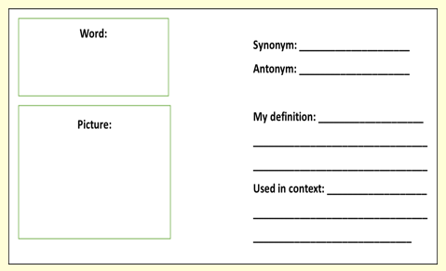
Vocabulary activity
regular
irregular
polygon
DEFINE IT / USE IT

Slide 7
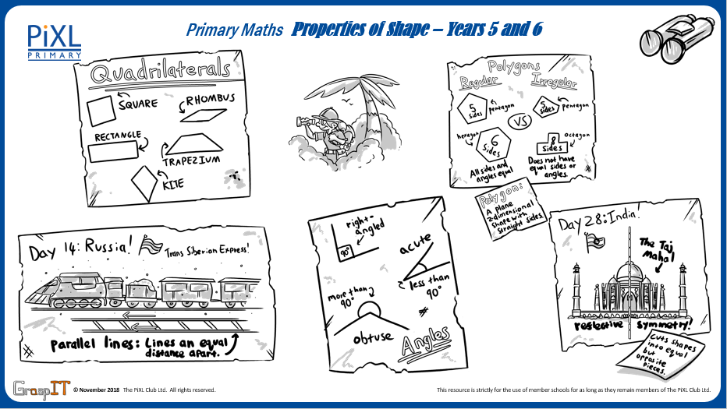
Notes:
Knowledge Mats can be helpful to support learning.

Slide 8
Teach
A 2-D shape is a form or an outline which is flat.
The ‘D’ stands for the word dimensional.
circle
rectangle
square
triangle
pentagon
hexagon
octagon

Slide 9

Teach
A quadrilateral is the name given to all 2-D shapes with four straight sides and four vertices (corners).
square
rhombus
kite
trapezium
rectangle
parallelogram

Slide 10
Teach
A 2-D shape can sometimes be described as a polygon.
Term | Definition
Polygon | A flat, 2-D shape with straight sides that are joined up.
Regular polygon | A shape where all angles and sides are equal.
Irregular polygon | A shape that does not have equal sides and angles.

Slide 11
Teach
A regular polygon is a shape where all angles and sides are equal.
An irregular polygon is a shape that does not have equal sides and angles.
irregular hexagon
regular pentagon
regular hexagon
irregular pentagon

Slide 12
Model
I can identify which of these octagons is a regular polygon and which is irregular by the length of each side and the angles.
To work out which is regular and which is irregular, I need to identify the angles and lengths of each shape.
A
B

Slide 13
Model
I can identify which of these octagons is a regular polygon and which is irregular by the length of each side and the angles.
Shape A has sides that are all the same length. I can check this using a ruler to measure each side.
A
I know that each angle is the same size too. I can check this using a protractor.
Therefore, this octagon is a regular polygon.

Slide 14
Model
Shape B has sides of different lengths.
B
I can also see that this shape has different angle types.
It has acute angles, reflex angles and a right angle. So, it is an irregular polygon.

Slide 15
Model
I can identify which of these octagons is a regular polygon and which is irregular by the length of each side and the angles.
As shape A has sides of the same length and the same interior (inside) angles, I know this is the regular polygon.
A
Shape B has sides of different lengths and different angles so it is an irregular polygon.
B

Slide 16
Apply
Complete the following table:
Shape | Regular or irregular polygon? | Reasons why

Slide 17
Apply – Problem Solving
Here are two 10-sided shapes (decagons). Explain which shape is a regular polygon and which one is an irregular polygon by describing the lengths of sides and angles.
A
B

Slide 18
Apply – Reasoning
Damien has to design two pentagons that are regular polygons.
He says that shape B cannot be a regular shape as it is longer in length than shape A.
Is he correct?
A
B

